Slide 1
#CAMHScampfire No.1
What does the evidence from a population-based birth cohort study tell us about the links between sleep in adolescence and anxiety or depression?

Slide 2
The agenda
Introductions
What is the research question?
Is this evidence valid?
What are the findings?
Is this valid, important evidence helpful?
Closing remarks
Please use the chat window to post any questions you have.

Slide 3
Hello!
Andre Tomlin (Chair, The Mental Elf)
Nkem Naeche (McPin Foundation Young Person’s Network)
Colin Espie (Blogger, expert sleep researcher and clinical psychologist)
Faith Orchard (Lead researcher)
Douglas Badenoch (Information specialist, Minervation)
Steph Lewis (Psychiatrist and researcher, ACAMH)
Please use the poll to tell us about yourselves!

Slide 4
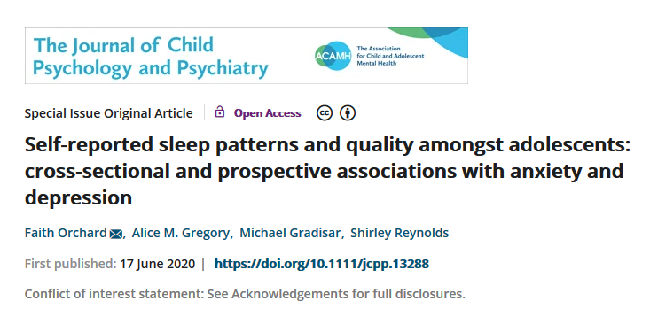
About the study

Slide 5

ALSPAC study
Avon Longitudinal Study of Parents and Children
Population-based birth cohort study
Clinical assessment at age 15 (N=5,033)
Outcomes at ages:
17 (N=3,528)
21 (N=3,463)
24 (N=2,853)

Slide 6
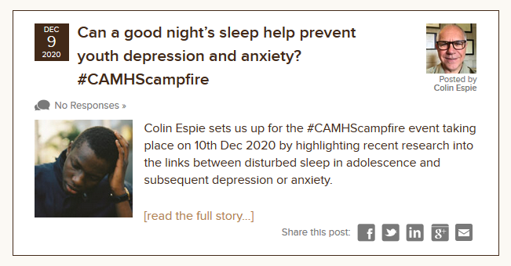
Our appraisal

Slide 7
Study methods
This first part of the study is a cross-sectional analysis
to examine sleep habits at age 15 years and
to compare the sleep quality and sleep patterns of those who met diagnostic criteria for an anxiety disorder and/or depression to those with no anxiety or depression.
The second component of the study is longitudinal
anxiety and depression were assessed when participants were aged 17, 21 and 24 years
Numbers were smaller at these follow up points i.e. N = 3,347; N = 2,363; and N = 2,719 respectively.
This tests the association between sleep patterns and quality at 15 years and symptoms and diagnoses of anxiety and depression that were present in late adolescence and early adulthood.

Slide 8
Study findings
There were two main sets of findings from the research.
15-year-olds with depression fell asleep later on school nights and reported getting less sleep on both school nights and weekends, than 15-year-olds with no depression. They also slept less well than those who were anxious but not depressed. 15-year-olds with depression or anxiety reported a wide range of problems with their sleep compared with those with good mental health.
Reporting having less total sleep time on school nights at age 15 years predicted receiving a diagnosis for anxiety and depression at ages 17 and 24 years.

Slide 9
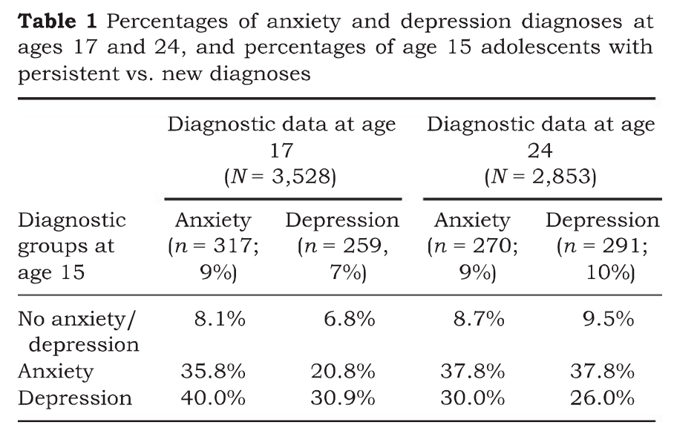
p1128

Slide 10
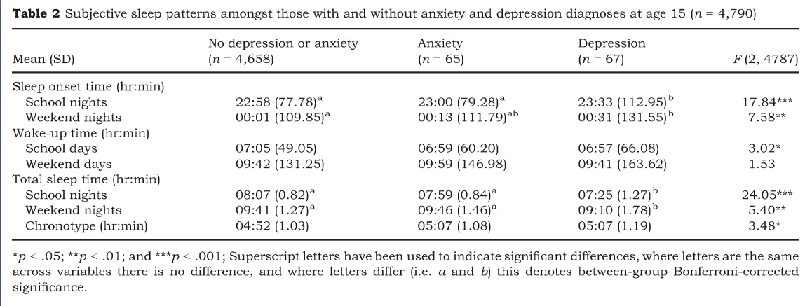
p1130

Slide 11
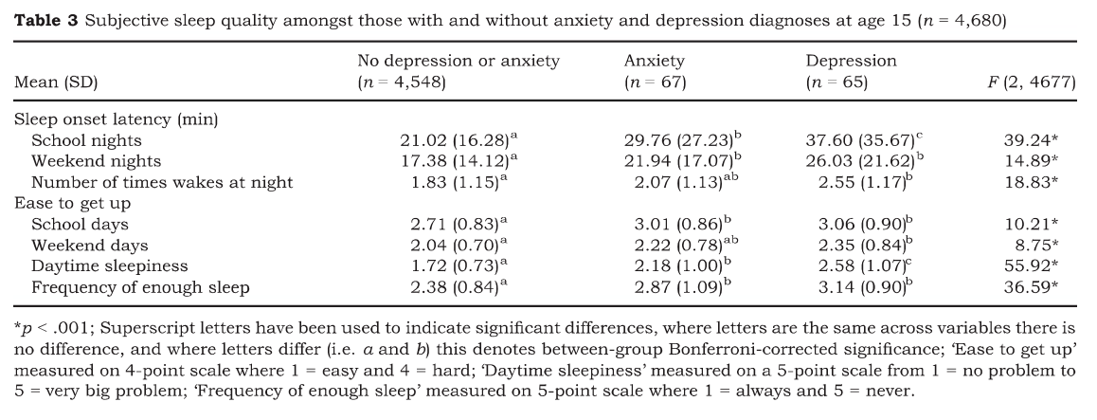
p1130

Slide 12
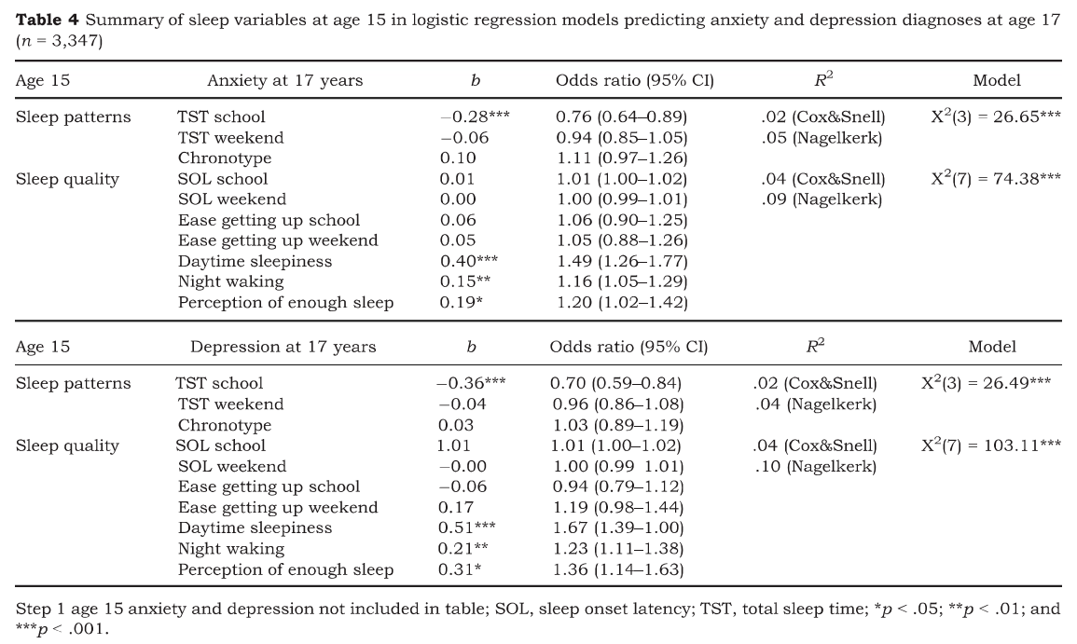
p1132

Slide 13

p1133

Slide 14
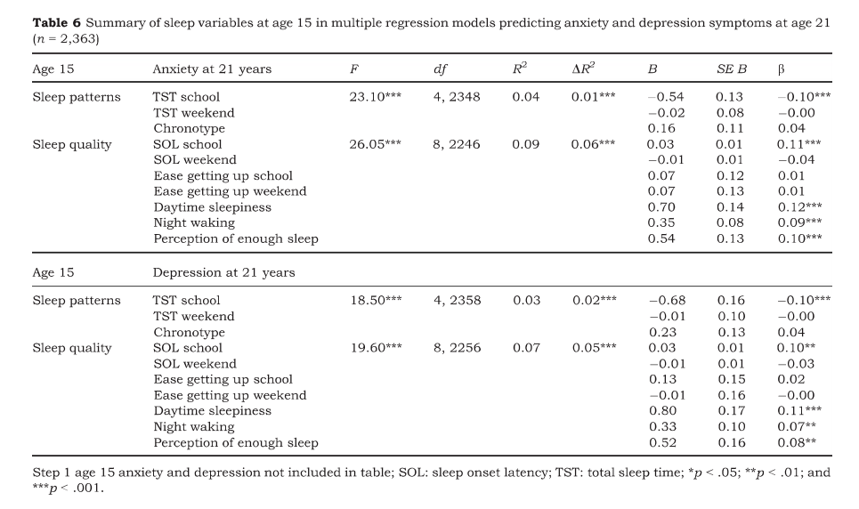
p1133

Slide 15
p1133

