Slide 1
#CAMHScampfire No.2
Voice-hearing in adolescence
Whispers, echoes, friends and fears: forms and functions of voice-hearing in adolescence

Slide 2
Agenda
Introductions
What is the research question?
Is this evidence valid?
What are the findings?
Is this valid, important evidence helpful?
Closing remarks
Please use the chat window to post any questions you have.

Slide 3
Hello!
Andre Tomlin (Chair, The Mental Elf)
Rebecca Burns (McPin Foundation Young Person’s Network)
Prof Emmanuelle Peters (Professor & clinical psychologist)
Dr. Sarah Parry (Lead researcher)
Douglas Badenoch (Information specialist, Minervation)
Dr. Steph Lewis (Psychiatrist and researcher, ACAMH)
Please use the poll to tell us about yourselves!

Slide 4
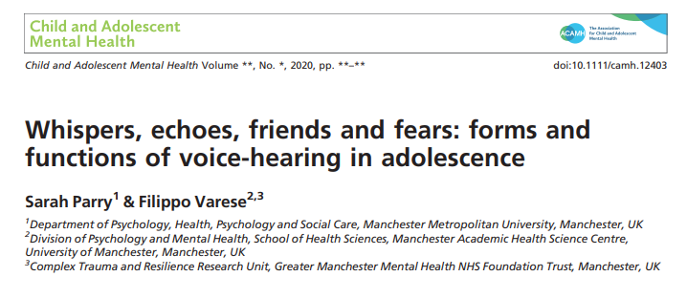
The research question
“The study aimed to advance the theoretical and phenomenological understanding of voicehearing for an under-represented group of young people with the objective of informing policy, research and practice guidelines.”
More about the Young Voices study @youngvoicestudy or http://bit.ly/39qoBc6

Slide 5
Study methods
Participants were recruited via social media, health trusts and support groups.
The researchers developed a specific platform for research engagement to safeguard confidentiality.
CYP aged 13-18 were asked to opt-in to the study if they identified as hearing voices that others could not. They did not have to have a clinical diagnosis or be connected to a mental health service.
The analytic method incorporated narrative and phenomenological analyses of the data from answering the study questions.
The researchers involved CYP with lived experience of hearing voices in the development of the online platform and also in evaluating the data.

Slide 6
Critical appraisal
CASP Checklist items | YES | CAN’T TELL | NO
1) Was there a clear statement of the aims of the research? | X
2) Is a qualitative methodology appropriate? | X
3) Was the research design appropriate to address the aims of the research? | X
4) Was the recruitment strategy appropriate to the aims of the research? |  | X
5) Was the data collected in a way that addressed the research issue? | X
6) Has the relationship between researcher and participants been adequately considered? |  | X
7) Have ethical issues been taken into consideration? | X
8) Was the data analysis sufficiently rigorous? | X
9) Is there a clear statement of findings? | X
10) How valuable is the research? | X

Slide 7
Critical appraisal
Self-selected sample + only 76% completed the survey to the end
Caution needed re: generalisability
Foucauldian-informed Narrative Analysis + phenomenological analysis =
Addresses issues of reflexivity, power and control
How participants understand their experiences

Slide 8
Study findings
Half of participants had not sought healthcare or community-based support
Participants reported negative (56%), positive (23%) and mixed (21%) emotions in respect of their hearing voices.

Slide 9
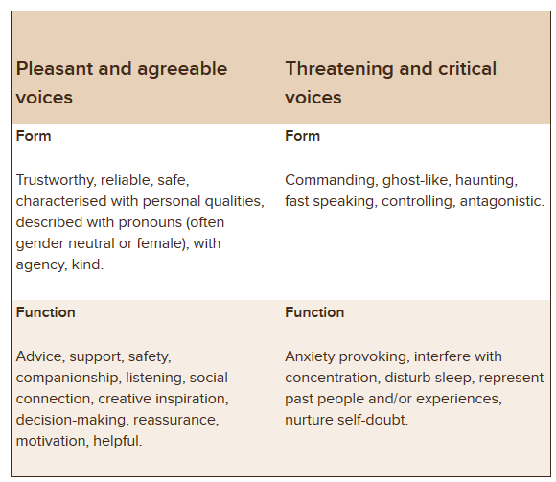
Study findings
There were important differences between positive and negative voices in terms of form and function.
They tended to find it more difficult to describe and understand negative voices.

Slide 10
Implications
Hearing voices has an impact beyond those with a clinical diagnosis
Hearing voices can have positive impacts as well as negative
Implications of the study platform:
“This survey helped me get my feelings out.”
“Thank you for giving me a place to talk openly about my experiences!”

