Slide 1
#CAMHScampfire No.5
Literature review of support tools for school staff to respond to CYP self-harm
Evidence from a systematic review of
training and support interventions in schools

Slide 2
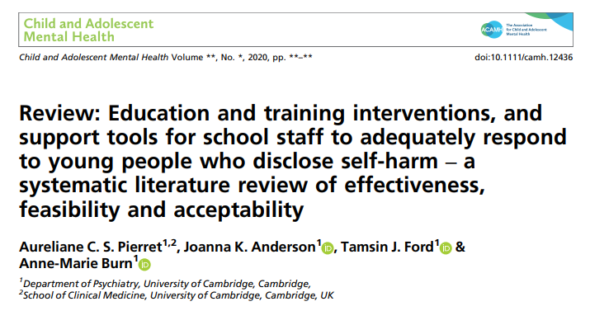
A systematic review attempts to identify, appraise and synthesize all the empirical evidence that meets pre-specified eligibility criteria to answer a specific research question. (Cochrane 2021)
Notes:
Systematic reviews aim to provide a definitive statement of what is currently known from research evidence. They are also useful in identifying areas of uncertainty, e.g. where evidence is lacking or inconsistent. Some argue that all research should begin by referencing a systematic review, so that we properly take into account what has gone before. In summary, they are an important and valuable contribution to knowledge.

Slide 3
The research question
Population
All schools staff
Interventions
Education, training or support tools
Outcomes
Knowledge, confidence and response re: CYP who self-harm
Study types
Empirical, cohort (longitudinal), qualitative.
Notes:
The first thing we need to be clear about when looking at any study is “what question are they asking here?”
In this review, the clear presentation of the inclusion criteria shows us clearly.
The participants or population included all school staff.
Interventions: they were many and varied, as we will see. Outcomes are proxies for what we are really trying to do: improve outcomes for CYP.

Slide 4
The review methods
Did they find all of the relevant evidence?
Good search strategy, however it is likely there is a lot of unpublished research
Did they assess the quality of the studies they included?
Yes, using a standard instrument
Did they do blind, independent checks of study inclusion and data extraction?
Yes, though only with a sample
Notes:
Criteria from the CASP systematic review checklist, link: https://casp-uk.net/casp-tools-checklists/.

Slide 5
Findings
Eight studies, looking at a wide range of interventions
Therefore, it was impossible to combine the results in one overall measure (meta-analysis)
The studies had a high risk of bias
Broadly, the interventions improved knowledge and were both feasible and acceptable
Less clear that the benefits were sustained over the longer term
No evidence was presented about the effects on experiences of CYP or outcomes
Qualitative findings
Equipping staff to respond, tailoring interventions, working across professional groups

Slide 6
Study | N | Population | Intervention | Outcome | Findings
Berger 2015 Australia | 48 | Teachers, MHPs, support & leaders | Policy addressing self-injury (SI). | Self-reports of quality, acceptability | The policy was relevant and acceptable.
Dorko 2010 USA | 25 | MHPs, teachers, nurses, support | Website with information and sources about SI. | Self-reports of knowledge and comfort re: SI | Useful information that improved knowledge.
Glennon 2020 USA | 94 | MHPs, nurses | Training session with handouts | Pre- and post-questionnaires | Statistically significant increase in knowledge.
Groschwitz 2017 Germany | 236 | Teachers, social workers, MHPs | Workshop on SI, including video and role-play. | Knowledge, confidence and behaviour measures; pre- and post-intervention; 6 month follow-up | Increase in perceived and actual knowledge; sustained improvement in confidence.
Lee 2016 UK | 10 | School pastoral staff | Training workshop. | Pre- and post- knowledge questionnaires; semi-structured interviews | Increase in knowledge; the training created a safe space for discussing self-harm.
Price 2015 USA | 32 | MHPs, nurses | Workshop in 2 parts: what SI is and how to manage it. | Pre-and post questionnaires on knowledge, confidence and self-efficacy | Increase in knowledge, possibly sustained after 6mo (very small sample size).
Robinson 2008 Australia | 213 | MHPs, teachers, support staff | Training over 2 days: what SI is and how to manage it. Handbook and CD-ROM. | Questionnaire, pre-, post- and at 6mo. | Improved knowledge, confidence and perceived skill; some evidence of skill retention. Participants with lower skills at baseline improved the most.
Townsend 2018 Australia | 400 | Teachers | Whole school initiative in 2 modules. | Knowledge, attitudes and confidence in SI | Improved knowledge, confidence and skills; additional support needs identified.
Notes:
MHPs = Mental Health Professionals Interventions: you can see how varied they are: workshops, websites, policies, plus a “whole school initiative”. It’s worth exploring the full text for the details of each intervention.
Pink: High risk of bias; Yellow: Moderate risk of bias
What we mean here by bias is that the findings could be down to limitations of the study, and not a true effect (e.g. small sample size, lack of blinding, subjective outcome measures)

Slide 7
Conclusions
Limitations of evidence; unpublished evaluations
Broadly, it seems we can affect the proxy outcomes (feasibility, acceptability, knowledge)
Expand to include “grey literature”
Tailored interventions, policies, peer support
Involve CYP in future evaluations
Person-centred outcomes, qualitative studies
Notes:
It’s difficult to conduct experimental evaluations in this field. But we can probably do more at little cost by including unpublished evaluations.
The studies were broadly consistent in their findings – it seems we can improve staff knowledge of self-harm. Whether this translates into a better experience and outcomes for CYP is not clear as yet.
Feedback from staff tells us that these work best when they are tailored, provided in the context of clear policy and roles, and include good peer support.

