Slide 1
#CAMHScampfire No.7 23rd June 2021
The effect of smartphone use on parenting
Evidence from a multiverse analysis of data from a survey of parents in Australia

Slide 2
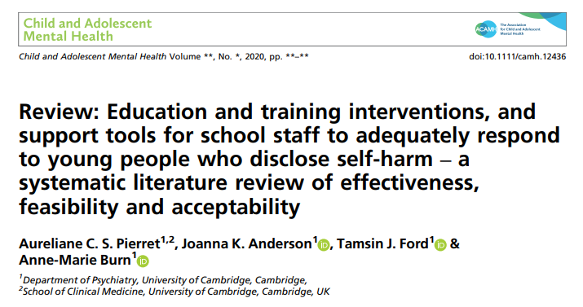
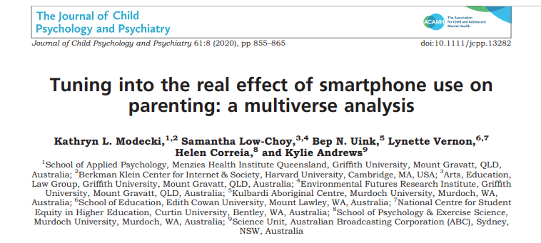
A multiverse analysis is a method of analysing data in which all the different ways in which a dataset can be interpreted.
Notes:
Effectively, the multiverse analysis is a survey with lots of statistical comparisons between the responses.

Slide 3
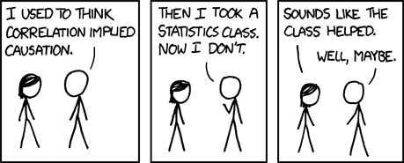
Reality Check No 1
Because they are observational studies, surveys can only identify correlations between things, and cannot prove that one causes the other.
Credit: XKCD
https://xkcd.com/552/
Notes:
Variable A might cause variable B, B might cause A, or an unknown variable C might cause both A and B.

Slide 4

Reality Check No 2
Because they are captured at a point in time, data from surveys can’t tell us what comes before what.
Credit: grendelkhan, Flickr, CC BY-SA 2.0 https://commons.wikimedia.org/w/index.php?curid=3275713
Notes:
This is why we need prospective, longitudinal studies.

Slide 5
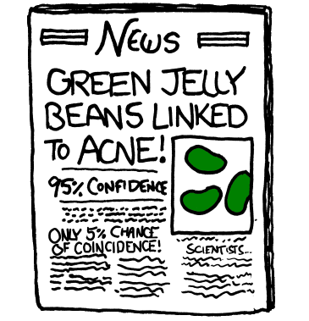
Reality Check No 3
When we do lots of analyses, there’s a danger we will be influenced by the play of chance, especially when we rely on p values.
We can always think of plausible explanations of random patterns.
Credit: XKCD
https://xkcd.com/882/
Notes:
e.g. ISIS2 trial – one of the most important trials ever conducted. The Lancet asked the authors to do a subgroup analysis before they would publish. The authors responded by sending in the results stratified by astrological birth sign (Richard Peto, anecdote presented at the Evidence Live conference 2016). The journal published the trial without a subgroup analysis.

Slide 6
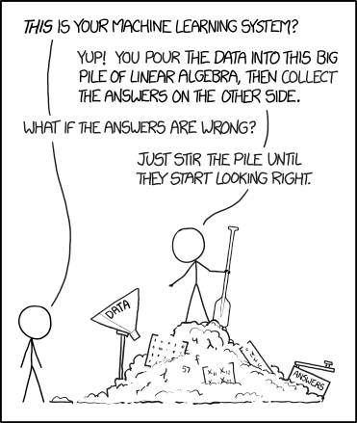
Reality Check No 4
Data in itself is meaningless. It only attains real meaning if it reliably represents what we’re interested in.
(External validity)
Credit: XKCD
https://xkcd.com/1838/
Notes:
We must never forget that what we are aiming to do is improve things for people, not improve numbers.

Slide 7
In this multiverse analysis
We need to bear in mind the limits of what it can tell us:
Correlation and not causation
Unclear direction of association
There’s a risk of “false positive” associations
External validity of the outcome measures is doubtful – are they really measuring what we think they are?

Slide 8

Find out more
For more awkward questions to ask about surveys, this critical appraisal checklist is open access and published in the British Medical Journal (BMJ).
Notes:
Will be helpful for those designing surveys as well as reading them

Slide 9
The research question
Population
All parents with children under 18 (and smartphones)
Exposures
Smartphone use, including nature and depth of engagement, and “technoference”
Device use interrupting interactions
Conflict from being ignored in favour of a device
Outcomes
Parental warmth, attachment

Slide 10
The study methods
Are the methods appropriate for this question?
Yes, the aim is to explore possible hypotheses
Were the respondents representative of the population?
Yes, efforts were made to include minority groups
Did enough of them respond?
Yes, though we don’t know about non-responders
Are the outcome measures valid?
Unsure; reliant on self-reports, external validity not tested
They cross-validated measures within their own data set, which helps
This is an important limitation on this study imposed by the technical constraints of the survey
Notes:
More information in the supplementary material about limits on outcomes / survey items.

Slide 11
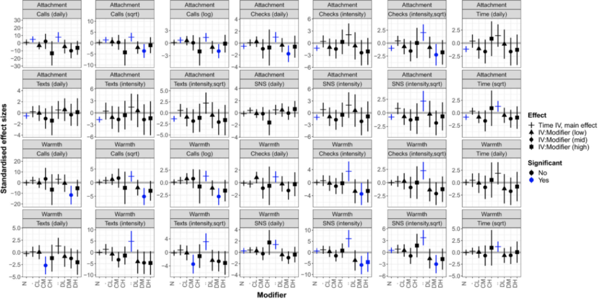
Results
3,659 respondents
The vast majority of variables were not associated with each other
There was little evidence to suggest smartphone use harms parenting
In fact, higher use of social media was associated with higher parental warmth
Technoference may mediate the impact of smartphones.
Notes:
Note: Absence of evidence, not evidence of absence.

Slide 12
Results

Slide 13
Strengths and limitations
Large sample size
Efforts made to make the survey accessible
Internal validation of the data
Self-reported data
The survey measures may not be measuring what we think they are
Cannot rule in or rule out any causal link

Slide 14
Conclusions
We must be cautious about any firm conclusions from this type of study
The data suggest that assumptions of harm from parents’ smartphone use may be wrong
It may even be beneficial, as long as phone use does not displace family time
Qualitative data is needed to understand these interactions in more detail
From there, we can work towards valid, person-centred outcomes that we can measure in future quantitative studies.
Notes:
We should ask what matters to parents and children, and measure that using validated outcomes.

