Slide 1

Foxgrove: National Secure Adolescent Inpatient Unit
Dr Helen Smith: Clinical Director
Victoria McInulty: Service Manager

Slide 2

Adolescent under 12 -18years old
In / From Scotland
Mental disorder
Mental Illness
Developmental disorder (Autism / Mild-Moderate LD)
Risk of harm to others
Physical / Sexual violence; Firesetting
(Many also serious risk of harm to self)
All genders
Cannot be managed in other setting:
Regional adolescent /Secure accommodation / Young Offenders Institution

Slide 3

Graveness of Violence | Behaviours
High (Grade 1) | Homicide Stabbing penetrates body cavity Fractures Skulls Strangulation Serial Penetrative Sexual Assaults
Medium (Grade 2) | Use of weapon to injure Arson Causes concussion or fracture of long bones Sexual Assaults Stalking with threats to kill
Low (Grade 3) | Self harm or attempted suicide that can not be prevented with 2 to 1 nursing in open conditions Repetitive assaults causing bruises

Slide 4
Updated Needs assessment

Slide 5
Updated needs assessment:
  13 referrals in 18 months
  12 met criteria
  1 YP spent 26 weeks in England
  1 YP in England currently
  Others adult IPCU, secure care

Slide 6
1 patient received 4-5 nursing staff special observations in an adult IPCU,
1 patient on special observations in an adult IPCU,
1 patient receiving 2:1 observations in adolescent unit for over 9 months
1 patient receiving 1:1 observations for 4-6 weeks in an adolescent unit.

Slide 7
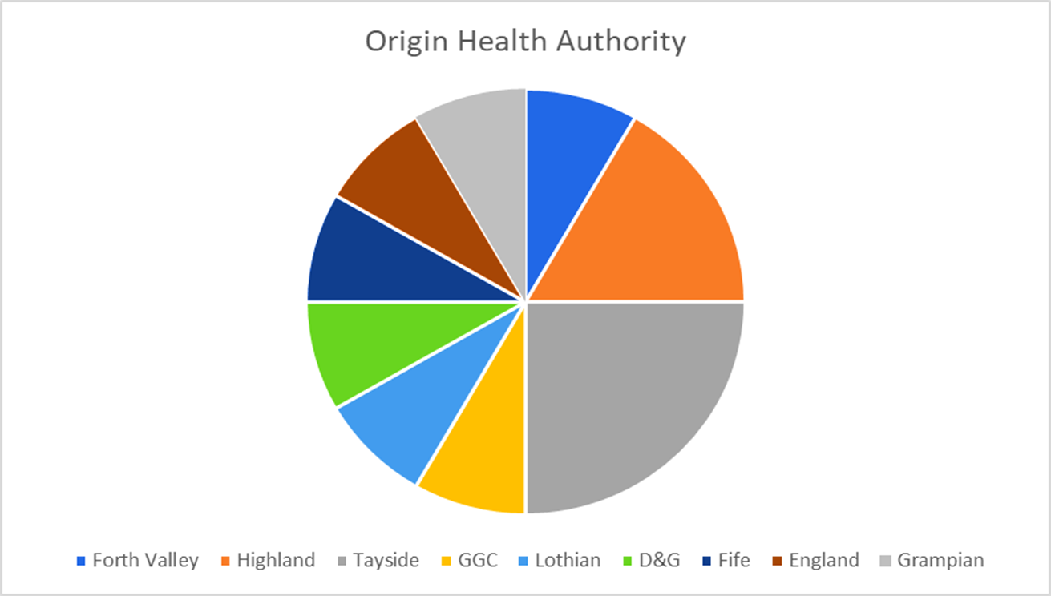

Slide 8
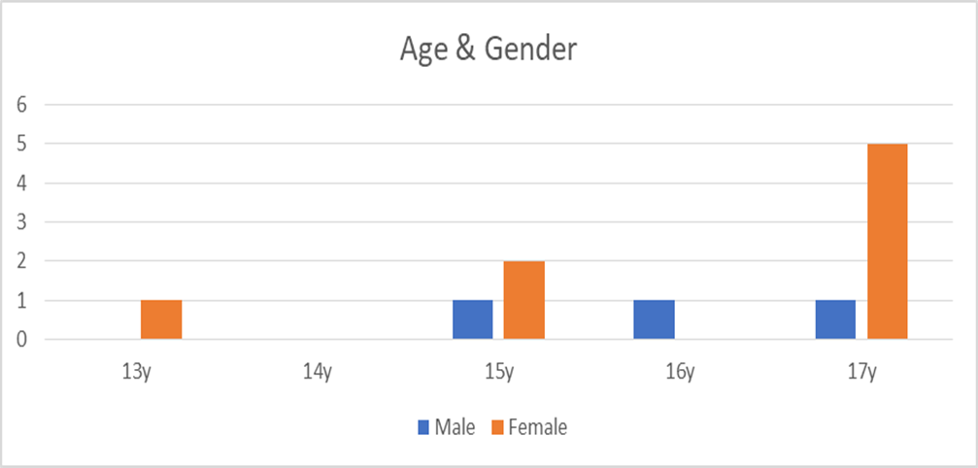
4 Male: 8 female
Average age mean 15.7 years (median 17 years)

Slide 9
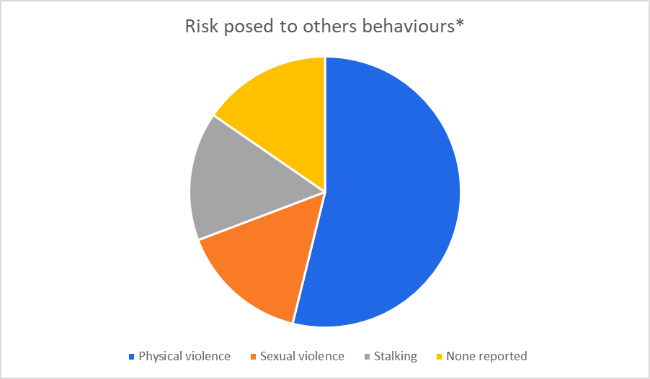

Slide 10
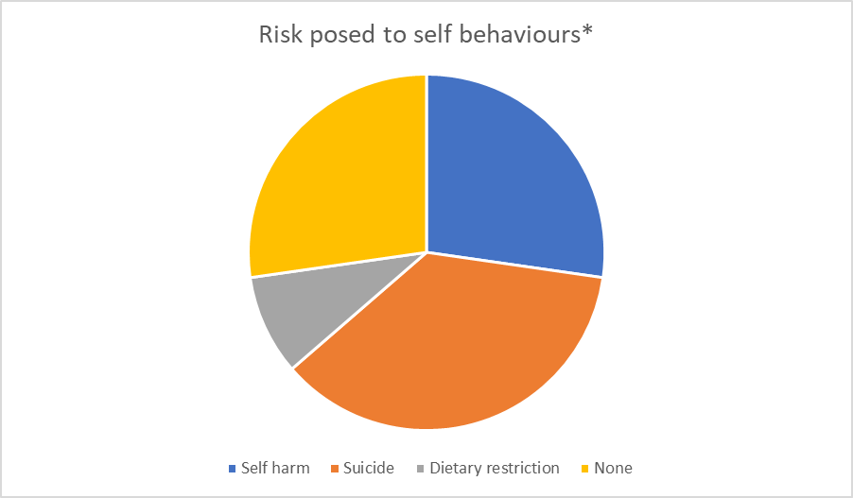

Slide 11
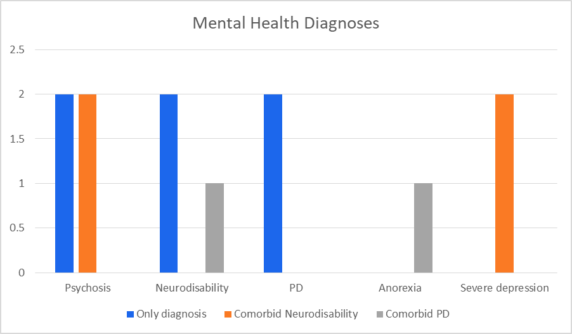

Slide 12


Slide 13
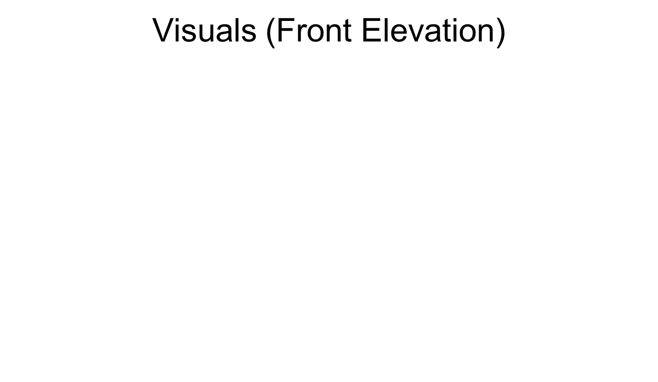
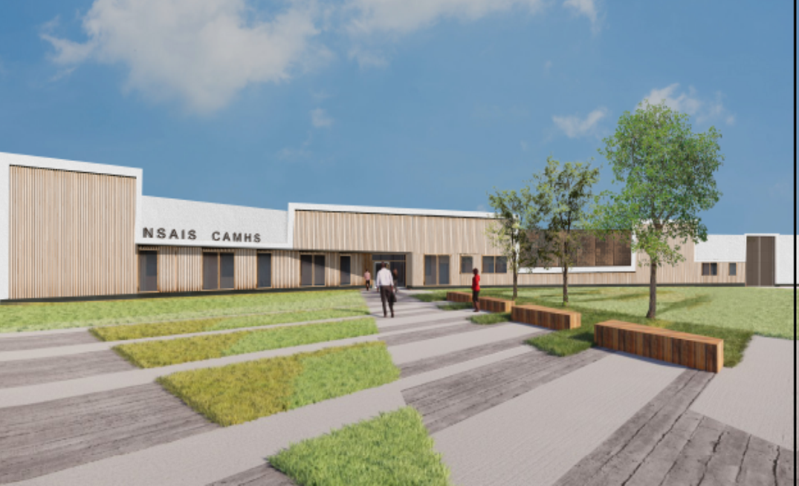

Slide 14
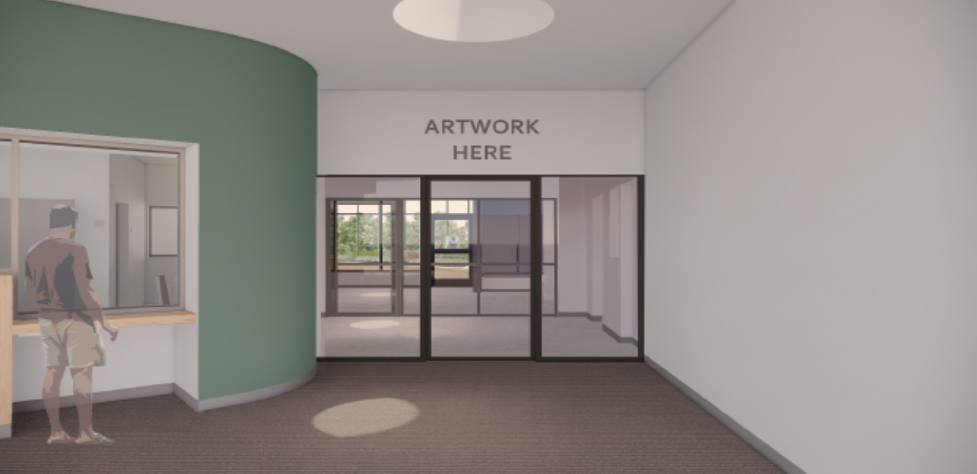
Visuals (Main Entrance)

Slide 15
Visuals (Classroom)

Slide 16
Visuals (Dining & Activity)

Slide 17
 |  | OBC | FBC | Difference
Building capital cost – incl External works and Value Engineering |  | £6,735,196 | £8,026,875 | £1,291,679
PSCP Costs – incl Agreed Compensation Events only |  | £455,000 | £640,592 | £185,592
Lead Advisor fees – incl Agreed Compensation Events only |  | £143,025 | £201,728 | £58,703
NHS in-house staffing costs |  | £296,064 | £636,752 | £340,688
Planning Fees and Building Warrant |  | £32,000 | £11,228 | (£20,772)
Allowance for Client Risk/ Optimism Bias |  | £637,666 | £435,000 | (£202,666)
Furniture & Equipment Costs – VAT incl |  | £297,085 | £304,263 | 7,178
Sub-Total |  | £8,596,036 | £10,256,437 | £1,660,401
VAT (Currently applied to building cost, inflation and PSCP cost (excl PSCP Building Warrant Cost) | 20% | £1,438,039 | £1,730,054 | £292,015
VAT Recovery | 12% | £(172,565) | £(207,607) | (£35,042)
AME Funding |  | n/a | £(503,574) | (£503,574)
Total |  | £9,861,510 | £11,275,310 | £1,413,800

Slide 19
Key Activity | Start | End | Duration
CIG Approval of Project | 21/04/21
Contractor Mobilisation Period | 26/04/21 | 04/06/21 | COMPLETE
Construction | 07/10/21 | 22/08/22 | 43 weeks
Commissioning | 25/08/22 | 20/09/22 | 4 weeks
Operational Date |  | ?24/10/22

Slide 20
WORKFORCE

Slide 21
Multi-disciplinary Team
Psychiatry
Psychology
Nursing
SALT
OT
Dietetics

Slide 22
Trauma Informed (places, spaces and staff)
Aligned with Standards of Care
Collaborative engagement
Training Needs
Review

Slide 23
Thank you
Any questions?

Slide 24
Emails: Dr Helen Smith: helen.smith4@aapct.scot.nhs.uk
Victoria McInulty: victoria.mcinulty2@aapct.scot.nhs.uk
Foxgrove:
aa.nationalsecure.adolescentinpatientservice@aapct.scot.nhs.uk
Follow us on Twitter @NHSaaa
Find us on Facebook at www.facebook.com/nhsaaa
Visit our website: www.nhsaaa.net

