Slide 1
#CAMHScampfire
Critical appraisal workshop on
The ADHD deficit in school performance across sex and parental education: A prospective sibling‐comparison register study of 344,152 Norwegian adolescents

Slide 2
Critical appraisal
What is the research question?
Is the study valid?
Are the valid results important?
Are the valid, important results applicable to us?

Slide 3
Types of question and types of study
Question | Type of study
What is the prevalence of ADHD? | Cross sectional observational study
What are the risk factors for poor academic performance? | Prospective longitudinal cohort study
What are the effects of school-based interventions in ADHD? | Randomized controlled trial
What are the experiences of people affected by ADHD? | Qualitative study

Slide 4
Types of question and types of study
Question | Type of study
What is the prevalence of ADHD? | Cross sectional observational study
What are the risk factors for poor academic performance? | Prospective longitudinal cohort study
What are the effects of school-based interventions in ADHD? | Randomized controlled trial
What are the experiences of people affected by ADHD? | Qualitative study
What is the best way to find out how ADHD affects school performance? | Please follow the Menti link in chat

Slide 5
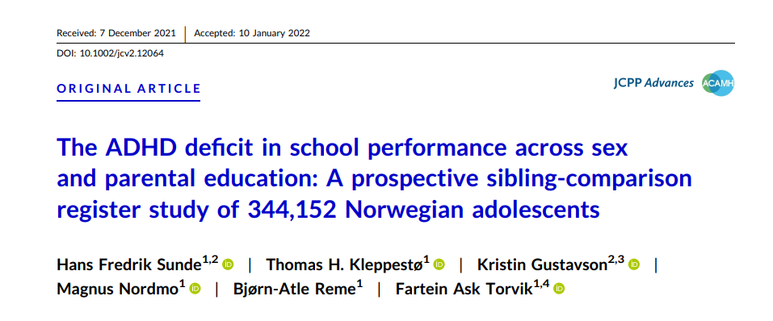
The study

Slide 6
Register studies
No validated appraisal tool
AHRQ User’s Guide, reporting guidelines
Assessed as a prognostic study
Population
Exposure
Outcome
Notes:
https://effectivehealthcare.ahrq.gov/products/registries-guide-4th-edition/users-guide

Slide 7
What we measure, and how
Exposures
Is it a valid measure?
Fair, objective measurement
Early enough in the course of the condition
Outcomes
Does it matter to young people?
Is it a valid measure?
Fair, objective measurement
Loss to follow-up

Slide 8
Confounders
Confounder Trauma
Outcome
Attainment
Exposure
ADHD
An observed association could be caused by other factors that haven’t been measured

Slide 9
Mediators
Mediator Poor attendance
Outcome
Attainment
Exposure
ADHD
Any observed association could be mediated by other factors that haven’t been measured

Slide 10
Survey results
What is the best way to find out how ADHD affects school performance?
https://www.mentimeter.com/app/presentation/4aecb0a7f90fa38a4957101d92e25675/7e0016d304e4

Slide 11
The study

Slide 12
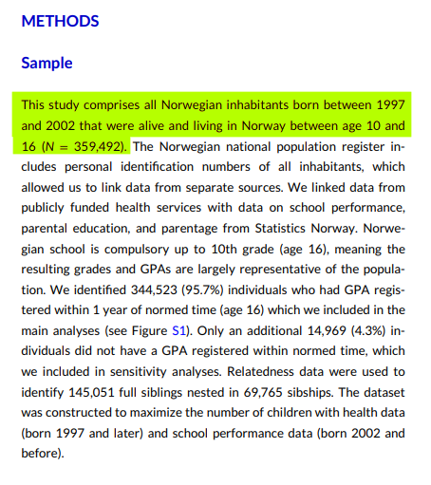
The population
Whole population:
Norway
Registry data from national primary care and education databases

Slide 13
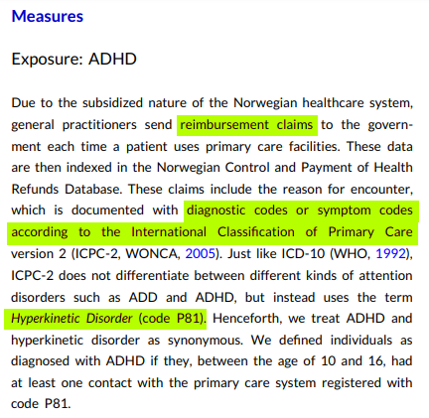
Exposure
ADHD:
At least one contact with the primary health care system that included International Classification of Primary Care code P81 (Hyperkinetic disorder), between ages 10 and 16.
We don’t know about type, severity or treatment of ADHD

Slide 14
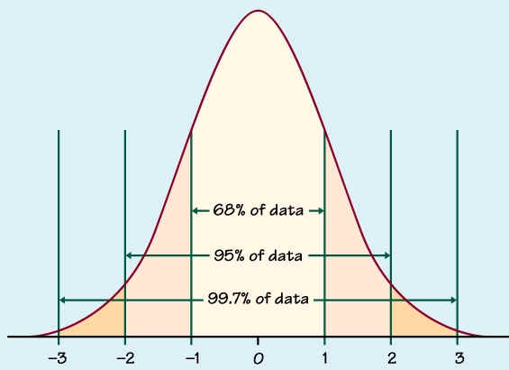
Outcome
School performance:
Grade Point Average (GPA) around age 16 (10th Grade),
standardised to z statistics (standard deviations from the mean)

Slide 15
Direction of causation
Does poor school performance precede ADHD diagnosis?
Early school performance measured as a control

Slide 16
The study questions
In people born in Norway between 1997 and 2002
What is the association between ADHD and
Academic performance?
How does this association combine with other factors?
Sex
Parental education
Academic subject

Slide 17
Critical appraisal criteria
Checklist item | Y/DK/N | Comments
1. Did the study address a clearly focused question? | Yes
2. Was the cohort recruited in an acceptable way? | Yes
3. Was the exposure accurately measured to minimise bias? | Yes | Primary care clinical coding
4. Was the outcome accurately measured to minimise bias? | Yes | Grade Point Average
5. (a) Have the authors identified all important confounding factors? | No | Not possible in this type of study
5. (b) Have they taken account of the confounding factors in the design and/or analysis? | Yes | Adjusted sensitivity analyses
6. (a) Was the follow up of subjects complete enough? | Yes
6. (b) Was the follow up of subjects long enough? | Yes | Age 16

Slide 18
Results
Analysis | Finding
Overall prevalence of ADHD | 4%
Boys vs girls | 5.5% vs 2.4%
Lowest education status vs highest | 6.9% vs 1.9%
Overall ADHD deficit | -0.86 SDs (95% CI -0.88 to -0.85)
Boys vs girls | -0.81 vs -0.99
Siblings with ADHD | -0.60 (-0.63 to -0.58)
Lower educational status vs higher | -0.70 vs -0.97
Notes:
Relative measures

Slide 19
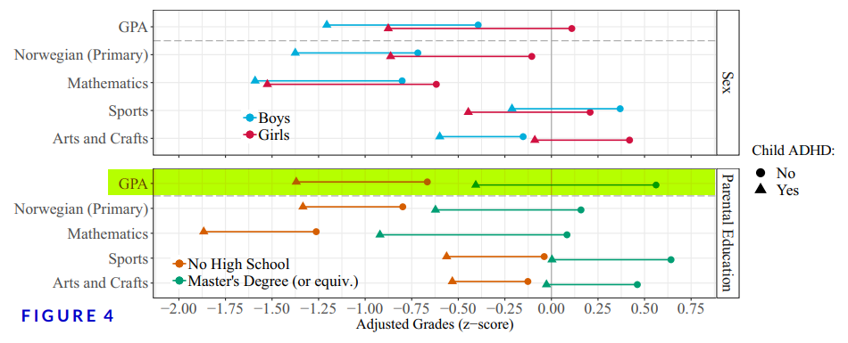
Results
Notes:
Note that Masters Degree parents’ children with ADHD still did better than No High School group without ADHD even though they had a higher relative “ADHD deficit”

Slide 20
What should we be doing differently to help young people with ADHD to achieve their potential in schools?
Please follow the Menti link in Chat to answer this question.
Please also submit any questions using the Q&A.

Slide 21
Strengths and limitations
Large sample, high statistical power
High follow-up rate
Setting
Ascertainment
Complex “confounders” such as family adversity, socioeconomic status, ethnicity
Averages can be misleading

Slide 22
Conclusions
Good quality study with low risk of bias
Clear indication of a substantial “ADHD deficit” in school attainment
Presence of ADHD preceded reduction in GPA
Much higher prevalence of ADHD where parents had lower educational attainment
People with ADHD had lower attainment than siblings without
Any implications for ADHD interventions? Should they be targeted differently?
Currently there is uncertainty around effectiveness esp of non-pharmacological interventions

Slide 23
Let’s see what you think
What should we be doing differently to help young people with ADHD to achieve their potential in schools?
https://www.mentimeter.com/app/presentation/4aecb0a7f90fa38a4957101d92e25675/7e0016d304e4

Slide 24
Image credits
XKCD 882: https://xkcd.com/882/
The z-score: http://www.ltcconline.net/greenl/courses/201/probdist/zScore.htm

