Slide 1


Fast Feet Forward
A protocol for complex trauma in adoption and looked after children
Dr Ana Draper, Consultant Systemic and Family Psychotherapist
River Draper, Director of Research for Improved Futures and Social Anthropologist
Elisa Marcellino, Clinical Director for Improved Futures - Clinical, Counselling and Health Psychologist

Slide 2

Location, Dislocation, Relocation Framework
‘Location, Dislocation, Relocation’ is an early intervention framework that targets the effects of complex trauma. It uses geographical descriptors to map and navigate relational processes, that entangle a sense of being located, dislocated, and relocated.
It creates a common language that facilitates a multi-disciplinary approach, and in the course of which, catalyses increased coherence, coordination, and efficacy within systems of care.

Slide 3
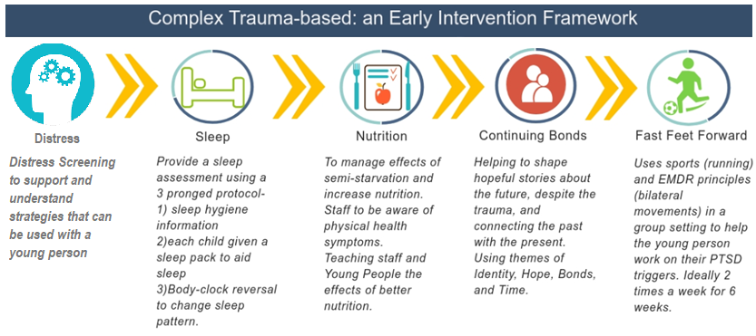
Relocation Tools

Slide 4
A Matrix For Playing Together
FFF builds a matrix of connectedness, that simultaneously weaves components of healing, play, autonomy, embodiment and relationality.
Approach: An understanding of complex trauma and its effect.
Method: A group protocol based in a non-clinical setting.
Technique: A phased approach.
Burnham, J. (1992) Approach, method and technique: making distinctions and creating connections.
Human Systems, the Journal of Systemic Consultation and Management, 3, 3-26.

Slide 5

The Voice of the Child

Slide 6
Why Fast Feet Forward?
It acknowledges the dislocation (trauma) that has occurred, the ways this is felt in the present, and the tools they have to shape their futures.
It is culturally sensitive, attuned to social difference, and adaptable to different demographics.
It is non-pathologising and normalising of trauma symptoms, resisting clinical diagnoses from becoming incorporated into identity.
It supports development of both relational abilities and autonomy, through collaborative self-management, which further fosters resilience.

Slide 7
The Formulation
Group
Dialogical and relational intensity (12 sessions over 6 weeks)
Targets hot spots
Bilateral fast feet movements that link to sport
*dialogical is about listening, empathising and responding without trying to create a logical conscious, but rather linking into relational life via hotspots.
Draper, A.; Marcellino, E; Ogbonnaya, C. (2021) Fast Feet Forward: Sports training and running practice to reduce stress and increase positive cognitions in adopted children. Counselling and Psychotherapy research.
Draper, A.; Marcellino, E; Ogbonnaya, C. (2020) Fast Feet Forward: Sports training and running practice to reduce stress and increase positive cognitions in unaccompanied asylum-seeking minors. Counselling and psychotherapy research.

Slide 8
Hotspots
‘Hot spots’ are trauma responses, including memories, beliefs and behaviours, that cause high levels of emotional distress.
Hot spots cause trauma to be re-experienced, through a reactivation of the original event/s and the associated emotions and cognitions.
Children with ‘complex trauma’ can have many different ‘hot spots’ that are frequently activated day to day. They may not have memories or a story to tell about the past.

Slide 9
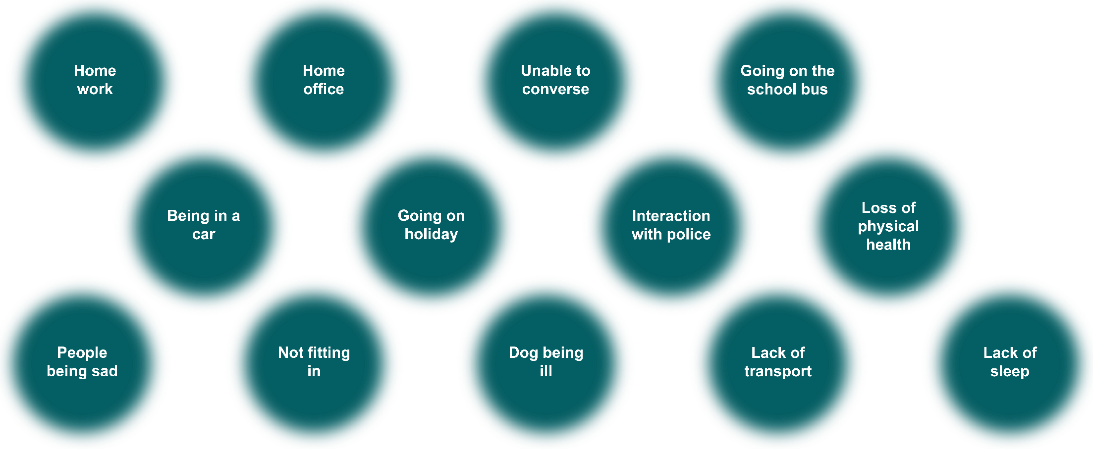
Hotspots
There are many hotspots that produce high levels of disturbance
linked to trauma. They are often not immediately obvious or easy to predict.
Examples of targeted hotspots by children:

Slide 10
What It Does
Brain
Body
Emotions
Reduction in anxiety, fear, worry & shame
Decreased tension & physiological arousal
Increased bodily awareness
Sensory integration
Bilateral integration
Non associative learning
Brain development
Distracting
Memory Change
Increased attention & flexibility
Emotions & Brain
The distancing effect: Problems are further away and smaller
Brain & Body
Feelings of safety
Whole Bran: Ability to use several parts of the brain
Integrated self
Ability to process
Reduction in the experience of isolation
Able to be more in the present
Memory and emotions are changed
Ability to trust is increased
Changes in response to stimuli
Emotions & Body
Regulation
The atomic model by Draper, A.; Marcellino, E; Ogbonnaya, C. (2020)

Slide 11
The Voice of the Child

Slide 12
What Is The Effect
Increases the validity of positive cognitions.
Reduces day to day levels of disturbance.
Produces self management strategies enhancing agency.
Has been reported to increase ability to learn.
Creates a foundation for healthy living patterns.

Slide 13
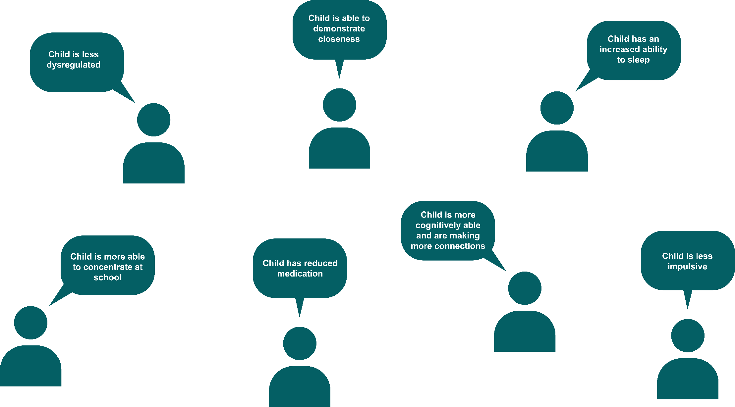
What Parents/Carers Say About The Protocol

Slide 14
What It Looks Like
https://www.youtube.com/watch?v=hqtBQoFH-ck

Slide 15
What The Data Shows
With UASC:
Validity of Cognition:
In a cohort of 29, there was a 41% change in enhanced cognitions. This was for
UASC who were able to attend 3 or more of the sessions.
In a cohort of 41 subjects (mean values pre and post)
N Mean Std. Deviation Minimum Maximum
VOC_pre 41 3.0487 1.33723 1.00 6.00
VOC_post 41 4.5965 1.45649 1.00 7.00
There was a statically significant change in cognition pre to post
(Z -4.974, p< .000, Wilcoxon Signed Ranks Test)

Slide 16
What The Data Shows
With UASC:
Self-reported Units of Distress:
In a cohort of 29, there was a 30% reduction in SUD’s. This was for
UASC who were able to attend 3 or more of the sessions.
In a cohort of 41 subjects (mean values pre and post across all sessions)
N Mean Std. Deviation Minimum Maximum
SUD_pre 41 7.3172 1.67889 3.50 10.00
SUD_post 41 6.0864 2.12430 .00 10.00
There was a statically significant change in distress pre to post
(Z -4.642, p< .000, Wilcoxon Signed Ranks Test)

Slide 17
What The Data Shows
In post adoption
Validity of cognition:
In order to analyse the full set of 82 paired VOC measures a Wilcoxon Signs-Rank
Test was performed. This suggested that there was a statistically significant difference
between the pre session VOC scores and the post-session scores (z=-4.622; p<.000).
The median post VOC session, Mdn=4.45 was statistically higher than the median
pre-session scores, Mdn=3.51.
Based on this analysis it was evident that the VOC within the post-session indicated that
children benefited from the FFF programme especially in their ability to endorse their
positive belief.

Slide 18
What The Data Shows
In post adoption
Subjective Units of Distress:
A Wilcoxon Signs-Rank Test was used to analyse the unique set of 82 paired SUD scores.
This also suggested that there was a statistically significant difference between the pre
session SUD scores and the post session scores (z=--5.065; p<.000).
The median post session SUD score was 5.22 compared to the median pre-session score
was 6.65.
These results suggest that the children felt less disturbed by their memory following their
FFF session.

Slide 19
The Voice of the Child:

Slide 20
Location, Dislocation, Relocation
“In the midst of winter, I found there was, within me, an invincible summer. And that makes me happy. For it says that no matter how hard the world pushes against me, within me, there’s something stronger — something better, pushing right back.” – Albert Camus

Slide 21
Other Papers That Inform Our Story
Draper, A.; Marcellino, E; Ogbonnaya, C., (2022) Continuing Bond Enquiry with refugees: Bridging the past and future. the Journal of Systemic Therapy, looked after children’s special edition.
Draper, A.; Marcellino, E; Ogbonnaya, C. (2021) Fast Feet Forward: Sports training and running practice to reduce stress and increase positive cognitions in adopted children. Counselling and psychotherapy research.
Draper, A.; Marcellino, E; Ogbonnaya, C. (2020) Fast Feet Forward: Sports training and running practice to reduce stress and increase positive cognitions in unaccompanied asylum-seeking minors. Counselling and psychotherapy research.
Draper, A. & Marcellino, E., (2020) An early intervention framework for emotional health and wellbeing of unaccompanied minors. Oxford textbook of Migrant Psychiatry. Chapter 68, pg. 589 – 596.
Draper, A., (2020) New perspectives on UASC health and interventions: beyond PTSD in Social Work with Refugees, Asylum Seekers and Migrants: Theories and skills for practice. Editors: Wroe, Larkin and Maglajlic.
Draper, A., (2018) Working with unaccompanied Asylum-Seeking Children: From dislocation to location of what can be: Metalogos Systemic online Journal.
Children’s Society (2018), Distress signals: Asylum seeking young people struggle for mental health care.
Hatzidimitadou, E; et al (2017), Evaluation of the sleep project for Unaccompanied Asylum seeking children in Kent. Canterbury and Christchurch University.
Johnston and Robinsons, CMMI Fellows (2017). Grief work, continuing bonds and co-creating new stories.
Draper, A., (2016), An emotional health and wellbeing specialist early intervention framework. BACCH News, Oct 2016 pg. 18 -21
The Coordinated Management of Meaning (CMM) (Cronen, Pearce, & Lannamann, 1982; Pearce, 2001, 2004). See http://article.sapub.org/10.5923.j.sports.20120205.02.html

Slide 22





Thank you for locating with us
info@improvedfutures.com
www.improvedfutures.com

