Slide 1
Working with Unaccompanied asylum seeking young people
Supporting Foster Carers to work with the traumatic responses of children and young people
Arnon Bentovim, Carol Jolliffe – Child and Family Training
Sue Holmes – Kent – Liaison Foster Carer

Slide 2
Introductions

Slide 3
Child and Training (C&FT)
Child &Family Training - a not -for profit training organisation
Goal – develop and train evidence -based approaches, resources and tools
‘Modular approaches’- Integrating the most effective elements to improve health and well-being

Slide 4
Goals of the Training

Slide 5
Focus of the training for foster carers
Share knowledge about adversity, stress, resilience and traumatic experiences of the children and young people in their care, the emotional and behavioural responses they have observed
Develop additional skills to help their young people in the light of their understanding of the emotional and behavioural responses of the children and young people they are caring for.

Slide 6
Foster carers lived experiences

Slide 7
Foster carers descriptions of the UASC
The enormity and extremity of the UASC experiences surprised and shocked experienced foster carers physical assaults, seeing death and destruction, committing atrocities, distressing nightmares highly stressful for foster carers, and secondary traumatisation could result
The UASC were described as generally respectful, despite tears and nightmares, frustrations not being able to communicate, until their English improved, even with translators, young people initially did not have a language to talk about worries, feelings, or low mood. Foster carers found ways of communicating, drawing, art, safe spaces to communicate, others v. silent,
Many of the UASC were surprisingly resilient despite the extreme stress of their sometimes-lengthy journeys, and took the bureaucratic processes in their stride, others are very anxious and fearful about being forced to leave the country. Foster carers found humour, sporting activities, normalisation to be important ways of helping young people emerge and relax. They want to be with peers, and share with them, telephone contact with families at home mitigates traumatic losses

Slide 8
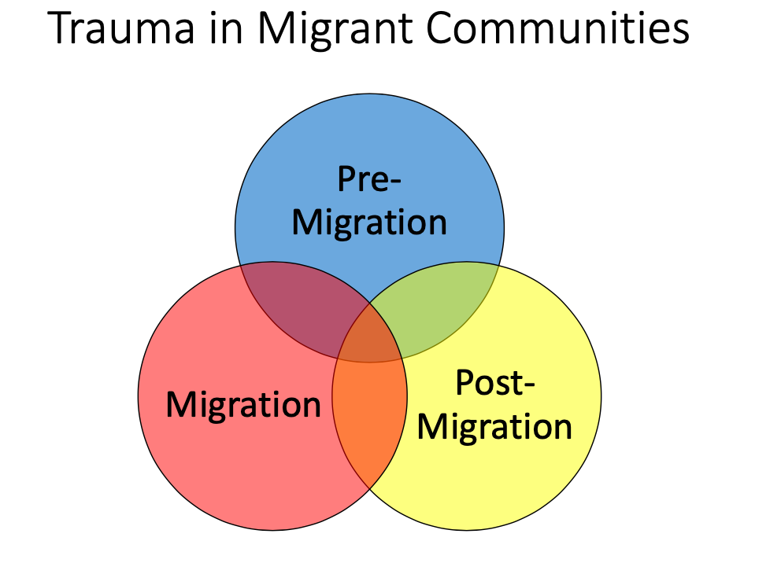
Migrant Communites

Slide 9
Intervention approaches

Slide 10
Basic Interventions to cope with distress and associated traumatic responses
The First session - Generic approach. Introduce the 4D approach to dealing with distress applicable to all children and young people- and their carers!!
The Second session - Specific interventions focuses on problems when there may be more extensive distress evoking a variety of mental health responses, difficulties with mood, anxiety, and traumatic responses.
The Third session – managing disruptive behaviour –positive parenting. -Review how the young people and yourselves have found using the material and future plans

Slide 11
Resources

Slide 12
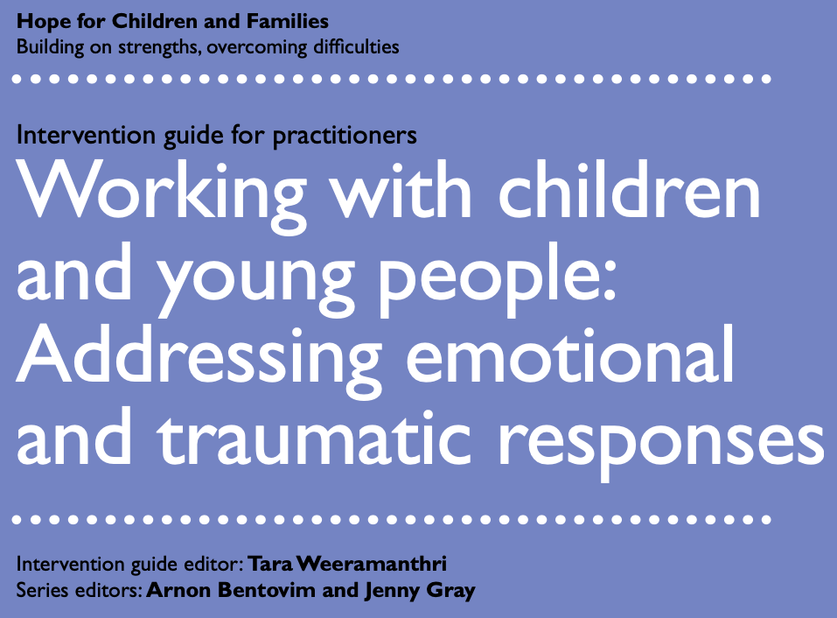

Slide 13
Working with children: emotional and traumatic responses. generic and problem specific modules
Generic modules
Safety planning
Coping skills
Relaxation and calming techniques
Describing and monitoring feelings
Activity selection
Problem solving
Problem specific modules
Helping with anxiety
Helping low mood
Helping traumatic responses
----------------------
Addressing disruptive behaviour additional and positive parenting

Slide 14
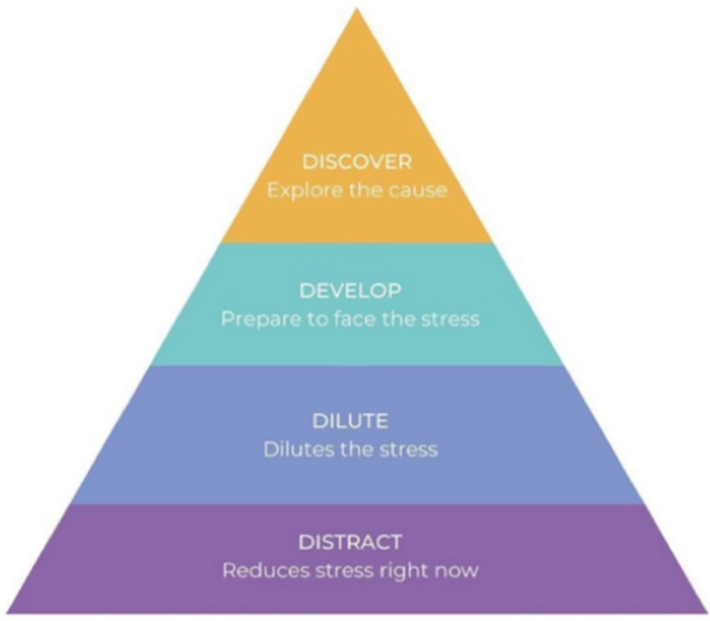
The 4D model of dealing with distress Mansell et al 2020
Distraction - Coping activities that act as a temporary distraction from distress. Their aim is to temporarily remove the experience of distress. The module ‘Ways of Feeling Good’ is the first module to help as a temporary distraction.
Dilution is a collection of techniques (Dilute) that enable young person to circumvent some of the processes that temporarily exacerbate distress. Their aim is not to remove the experience of distress, but to reduce its intensity whilst still experiencing some, manageable, degree of distress.
Develop. The third step introduces the opposite side of the coin – the need to think about, and talk about the problems, even though this can feel distressing.
Discovery, encourages the benefits of speaking one’s problems out loud to hear them in one’s own voice, develop new perspectives

Slide 15
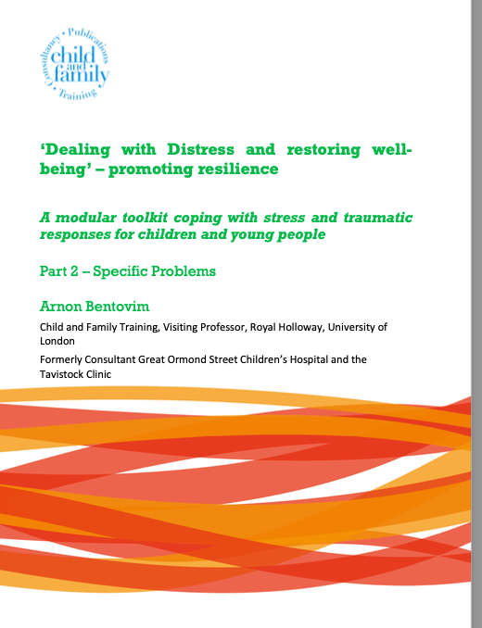
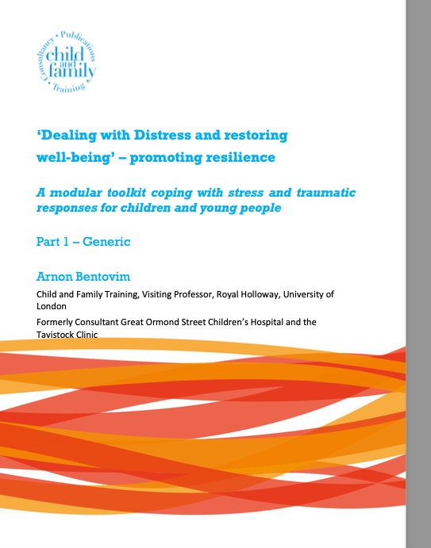
Guides for Foster Carers and UASC

Slide 16
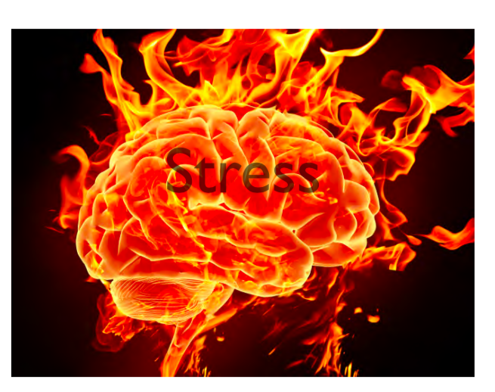
Dealing with distress- the core response
Distress -extreme anxiety, sorrow or pain in the face of adversity when we feel we have lost of control over valued life experiences – work, family, education, -
Distress is on the border of ‘manageable stress’ which strengthens when we find support, and ‘overwhelming stress ‘ –without support – toxic stress – with extensive harmful effects on mental and physical health – life long

Slide 17
Dealing with distress

Slide 18
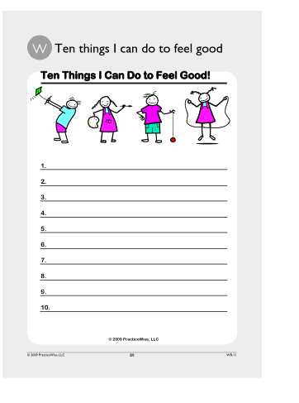
Distraction Ten Ways of feeling good
Use the work sheet and list to identify 10 ways the child or young person can do that could be scheduled ‘to feel good’

Slide 19
Dilution -Breathing exercises to enhance relaxation

Slide 20
Initial training in deep-muscle relaxation
If you can relax tense parts, you will be taking the first step in coping with these feelings.
-Get into a comfortable position, with eyes closed and practise deep breathing
-The start to clench and relax a fist, flexing and extending arms, tensing tummy muscles and thigh and calf muscles
The ultimate goal is to recognise tension in the body and then work to relax it.

Slide 21
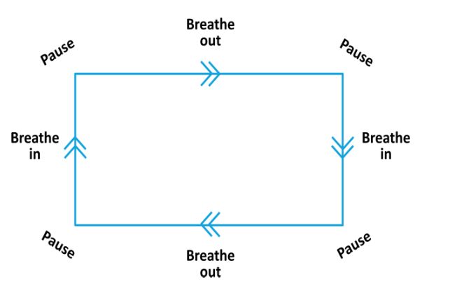
Square Breathing
Square breathing is a helpful technique–
Find a square object – a picture, or mirror – track the shape with your eyes and breath out as you track along the top,
Then pause at the corner, breathe in as you track down the side –
pause at the corner, breath out as you track along the bottom, pause,
breath in as you track back up and pause – repeat several times

Slide 22
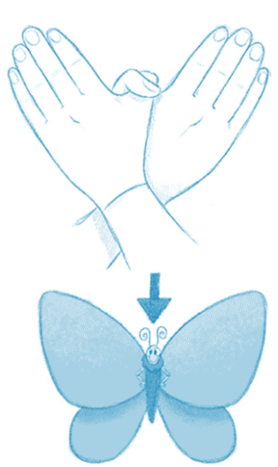
The Butterfly Technique (Jarred and Artiga 2010, Mansell, Urmson and Mansell 2020)
The Butterfly Hug is a grounding technique people can practice to self-soothe when under stress. The Butterfly Hug was developed by two practitioners, Lucina Artigas and Ignacio Jarero, adapted by Mansell et al,2020 and Luber 2022
Cross your arms over your chest, and interlock your thumbs to form the butterfly’s body and the extension of your other fingers outward will form the Butterfly’s wings.
Your eyes can be closed, or partially closed, looking toward the tip of your nose.
Next, you alternate the movement of your hands, like the flapping wings of a butterfly. Let your hands move freely.
You can breathe slowly and deeply (abdominal breathing), while you observe what is going through your mind and body such as thoughts, images, sounds, feelings, and physical sensation without changing or pushing your thoughts away. You can pretend as though what you are observing is like clouds passing by.
In your imagination go to a safe place , what are the images, colours, and scenes –you see – repeat the movements 6 -8 times – until you feel calm – try to draw your safe place – return to it when you need to
Use when:
Feeling anxious or emotional distress
Feeling overwhelmed with thoughts, flashbacks, re-experiencing
Use to help you share your distressing thoughts and feelings
Feeling disconnected
To help you sleep
Common experiences:
Gives you control of how you sense your outside environment, meaning you feel less 'cut off’ from things around you
Feeling more relaxed and balanced
Feeling more heart-centered
Feeling more resourced and re-connected

Slide 23
Develop
The third step of the session,– Develop - introduces the opposite side of the coin – the need to actually think about and talk about the problems you are having, even though this can feel distressing. This is a step to prepare to deal with stress. The idea of ‘worrying time’ to write or talk about worries

Slide 24
Discovery
The fourth step – “Discovery” encourages the benefits of speaking one’s problems out loud to hear them in one’s own voice, drawing, writing
Actively listening to help explore a problem, without giving advice, interpretations, or solutions, and helped to notice new perspectives

Slide 25
Feedback on the 4D approach
The general feedback. The work-books were helpful. Working through material without sufficient language could be challenging. Young people in high states of anger and frustration could not hear or focus, wait for the volume to settle down, the right moment, something to offer, the right time, resource would be available, natural curiosity
Distract and Dilute -The Butterfly Technique a form of EMDR -Bi-lateral Eye Movement, Desensitisation and Reprocessing approach, with breathing techniques was found to be particularly helpful to deal with distressing images, flashbacks, feelings, and thoughts
Developing and Discovering - extreme experiences - a brother kidnapped, a dead body of a relative being returned, shared losses; tears and crying, experiences shared and witnessed. Triggers, Home Office interviews, a plane or helicopter flying past, fireworks, torches, images on the television. Coping techniques essential, practical cooking, caring for animals, promotes safety, helps manage stress responses
The process of managing stress - distracting, diluting, developing, and discovering and sharing experiences constant process, had to be addressed frequently over the training.

Slide 26
Dealing with specific mental health issues

Slide 27
Dealing with anxiety
Observations
The theme of anxiety resonated for foster carers, young people were described as suffering persistent sleeping difficulties, some were in a highly anxious state, a perpetual state of fear., fears that their homes would collapse during a storm.
Some UASC’s fears were attributed to previous actions, fears that having been involved in aggression killing, that anger might cause a repetition associated with intense guilt.
Practical approaches to deal with anxiety need to help young people struggling with ‘crippling ‘ anxiety – e.g. fears of travelling on the bus.
Steps
Understanding situations which give rise to anxiety understand which are true alarms, needing avoidant action, or which are false.
Understanding the process of threat, the way anxious thoughts are bult up, and need to be confronted.
The Fear -Ladder Controlling anxiety –the least to the most worrying, practice being in situations which caused fear overcome, by being confronted
STOP -Countering anxious thoughts Work out first steps to identify a scared situations, worrying thoughts, and generate other thoughts

Slide 28
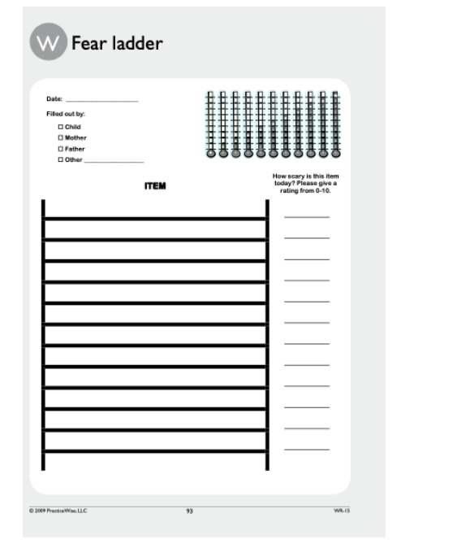
Controlling Anxiety –Fear Ladder
Think of situations make you anxious either now or in the past
Rate how worried they make or made you feel - on a scale of 1 to 10 (10 being the most scary).
The idea is to check and find out in order to discover if an alarm is true or false. You need to put yourselves into situations you are scared of to see if the bad thing that is feared happens or not.
Only by practising in situations that make you nervous will you learn to control excessive anxiety.
Overcome worries by confronting them. It involves doing something new in small steps, often accompanied by initial anxious feelings until the skill becomes part of the your repertoire – e.g fear of dogs

Slide 29
Dealing with low mood
Observations
Depressive states were frequent charecterised by dark moods, being sulky, empty spaces in their minds, blanked out experiences. Extreme anger and unhappiness was expressed more as tears rather than rage.
Distress and low mood may be triggered A Home Office interview, when young people hear about events in their own country - volcanoes erupting, loss of life.
Feelings of loss and grief Periods of sadness, and grief,. not knowing the fate of their families, fearing the worst for themselves, having to leave the country, thinking they had forgotten the sound of their parents’ voices.
Capturing memories, photographs drawings of their homes and parents to restore the past, rather than being overwhelmed with the sense of loss, emphasize that the young people were alive, they could rebuild their lives, could help their countries
The need for different approaches to improve mood - getting into a happier place, when young people are feeling low
Steps
Use the feelings thermometer to think of times when they have been most happy or sad what contributed to those feelings
What are you like when you are down, different ways of reacting and responding to stressful situations?
Changing feelings changing what we feel, what we think and what we do.
Changing our thinking when there are ‘BLUE’ Catastrophic thoughts, is to substitute ‘TRUE’ more realistic thoughts, feelings and behaviour
Changing behaviour - Presenting a positive optimistic self can improve mood and have a positive effect on relationships
Exploring difficult situations. ’Hot spots’ difficult situations, which are upsetting you, and made you feel low, e.g., Home Office Interviews?

Slide 30
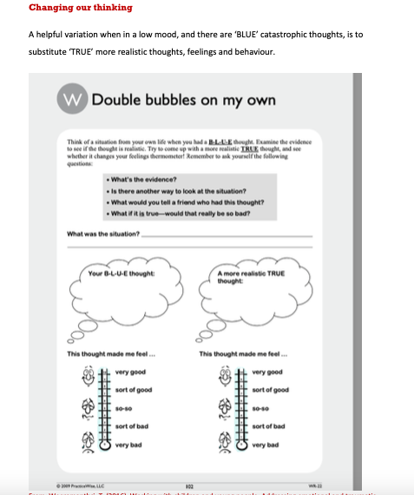

Slide 31
Creating a Trauma Narrative
Traumatic memories are different to memories of other events -tend to come into people’s minds uninvited, flashbacks often vivid, feels as if the event is happening again. Sleep may be invaded, nightmares and bad dreams triggered by sights, smells of places which remind of the original event. Lives feel fore- shortened, they are on edge, aroused, angry, irritable, cannot settle to sleep
Memories of events or events need to be brought to mind and processed, likely to be accompanied by a great deal of fear horror and helplessness. However, thinking or talking through events might help to reduce symptoms, and become a bad memory not current reality

Slide 32
Handout: Explaining the rationale for trauma-focused work: Why it’s good to talk

Slide 33
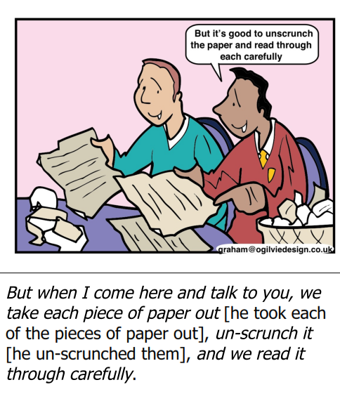

Slide 34
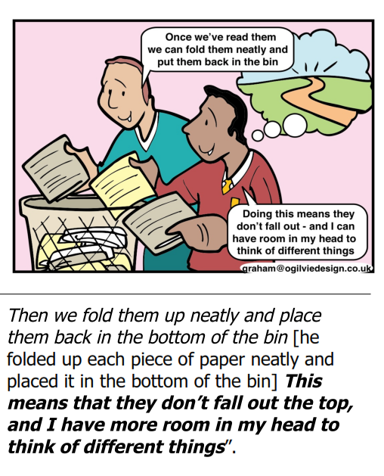

Slide 35
Constructing a Trauma Narrative – My Journey
Steps
Gradual Exposure - The basic idea is gradual exposure gradually work through the scary and upsetting things. Not all at once but the more you talk about all of this the sooner the whole you can cope and take over will be able to move on and get on with your life.
Utilise all the ways of coping already explored -to manage feelings and thoughts, feel safe, experiences are in the past and bad memories you are so much more than that.
Regular times to communicate. Memories may be stored as files on computers, photographs on phones, kept up to date, stored in a memory box, into a book, bringing memories up-to-date. Memories and experiences need to be slowly unwrapped
Observations
Recognition of the importance of establishing a Trauma Narrative of their journey. Despite reluctance, it was recognised that having a full narrative - a hardback version of the journeys -could demonstrate e.g. to the Home Office the range, extensiveness, and depth of the traumatic experiences. Memories gradually return, watching a TV program about their country, pictures of their home-towns, images, stories, details.
Getting ensnared in their stories. Some UASC could become caught up in their experiences, watching films of highly traumatizing bombing and barbaric events. This could be highly risky.
Constructing their experiences. Constructing a detailed account of their journeys, videos with commentaries in their own language., want to be in touch with their family making connections.

Slide 36
Angry, disruptive Behaviour Antecedents, Behaviour and Consequences

Slide 37
Managing angry disruptive behaviour
Steps
Analysing incidents when young people find themselves getting angry and losing their tempers - pathways –thoughts, feelings, behaviour and consequences. Finding an alternative, Justifications blaming others, assuming the worst, minimising the impact
Turning over a new leaf – Old lives and New Lives getting grouchy and irritable, can define you , temper is in control,. find solutions ‘Defeat Mr Temper, and let ‘Mr Cool’ emerge.
Positive Parenting to manage disruptive behaviour. understand factors associated with the development and maintenance of negative behaviour, and to introduce a number of different approaches to improve the behaviour through positive approaches.
Getting angry, irritable, argumentative, defiant or vindictive, touchy, easily annoyed, angry, resentful, non-compliant
Serious sulking behaviour, not communicating, talking in their own, making demands which foster carers do not have the authority to arrange e.g. meeting relatives, say what they think people want to hear.
Steps There may be phases of defiance, boundary breaching, not respecting space, shouting on their phones, turning the music up, slamming doors day and night, will they be punished, arrested deported. Foster carers find their tolerance is stretched, they need good humour
Defiance of female foster carers. Some find it hard to accept that a female foster carer is in charge, and can be particularly defiant to them, less to male foster carers

Slide 38
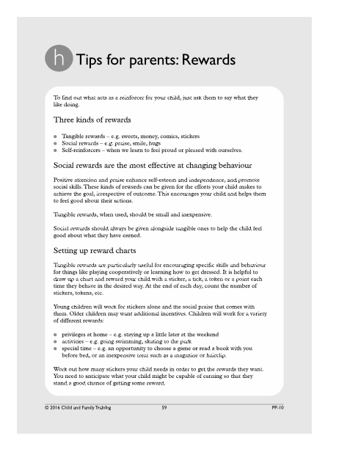
Tips for parents – Rewards
Rewards are an important tool for encouraging positive behaviour
Different kinds of rewards:
Tangible rewards, for example, money, sweets, comics
Social rewards, for example, smiles, hugs, praise
Self-reinforcers, for example, when we learn to feel proud or pleased with ourselves
Social rewards should always be given alongside tangible rewards as this helps children feel good about what they have earned and in the longer term the good feelings act as a reward in themselves.
Rewards are given after a positive behaviour - this is not the same as a bribe which is usually given before expected behaviours
Charts can be used younger children with stickers, tickers or stars. Older children can have points charts. They should be kept simple and clearly focussed on one target behaviour at a time.

Slide 39
Application
.
A foster carer described a situation when a young person had been questioned by the police, when he had smashed a vodka bottle in frustration against the door of the house, when he was not admitted to a party, having been asked to buy drinks.
Going through the steps of thoughts, feelings, and responses to find an alternative approach was seen as potentially helpful.
The concept of ‘Old Me’ and ‘New Me’ was seen as as helpful concept to help young people establish a new identity, leaving behind the feelings thoughts and behaviour associated with their journey

Slide 40
Overall Feedback and recommendations
Overall view there was a consensus sessions had been helpful. they felt safe, essential if they were to share some of the extremely painful material they have heard, which they must process themselves.
A zoom training fewer opportunities to have individual discussions, some would be unable to attend face to face trainings.
Feedback on skills trained many of the skills trained were valuable in helping these often deeply troubled young people subjected to extremely stressful traumatic experiences both in their home countries, during their journeys, and in the UK.
Feedback on resources. Foster carers found it valuable to have a ‘bank’ of resources, the workbooks ‘Dealing with Distress and restoring well-being’ – promoting resilience -A modular toolkit coping with stress and traumatic responses for children and young people were helpful as tools to work through with young people.

Slide 41
Feed back
Specific needs of UASC. -language difficulties, the role of translators, audio guides, and Easy Read. Extreme anxiety, tension and continuing stress, was an obstacle to work though steps systematically. The focus needed to be on the core issues for them, calming techniques, the EMDR derived techniques – Butterfly Techniques and Bilateral activities, Sleeping Techniques, and approaches to being able to establish a coherant Trauma Narrative.
Foster Carer reflective group support to prevent secondary traumatisation was essential, opportunities for refreshers, regular consultations to discuss their work with young people.
The value of the course for general training of Foster Carers useful if the training had come earlier, as part of their core training. Preferably in their second year, rather than in the first year., need to have experience of working with looked after children. Course would need to be longer
The training confirmed and reinforced what they were already doing day to day, what they had learned from their work with young people.

Slide 42
Potential Training Plan
Session 1 Introductions – Establishing the needs of children and young people
Sessions 2 Introducing the 4D Dealing with Distress including Bilateral EMDR related activities
Session 3 – Addressing anxiety
Session 4– Addressing low mood
Session 5– Establishing a Life Journey – Trauma Narrative
Session 6 – Addressing disruptive behaviour and developing positive parenting skills.
Session 7 -Integration of intervention, endings.

