Slide 1


Slide 2
Understanding Self-harm
With Professor Barry Carpenter & Professor Dennis Ougrin

Slide 3

Self-harm and Suicide in Young People
Professor Dennis Ougrin, QMUL

Slide 4
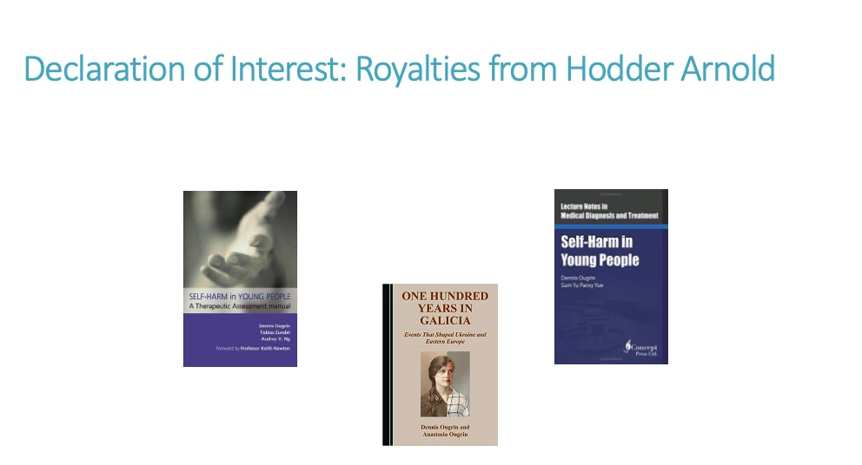

Slide 5
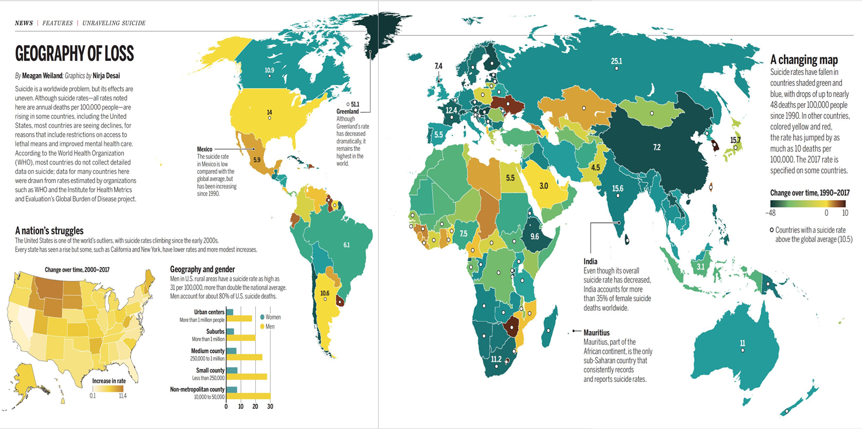
Suicide worldwide
Desai et al., Science (2019)

Slide 6
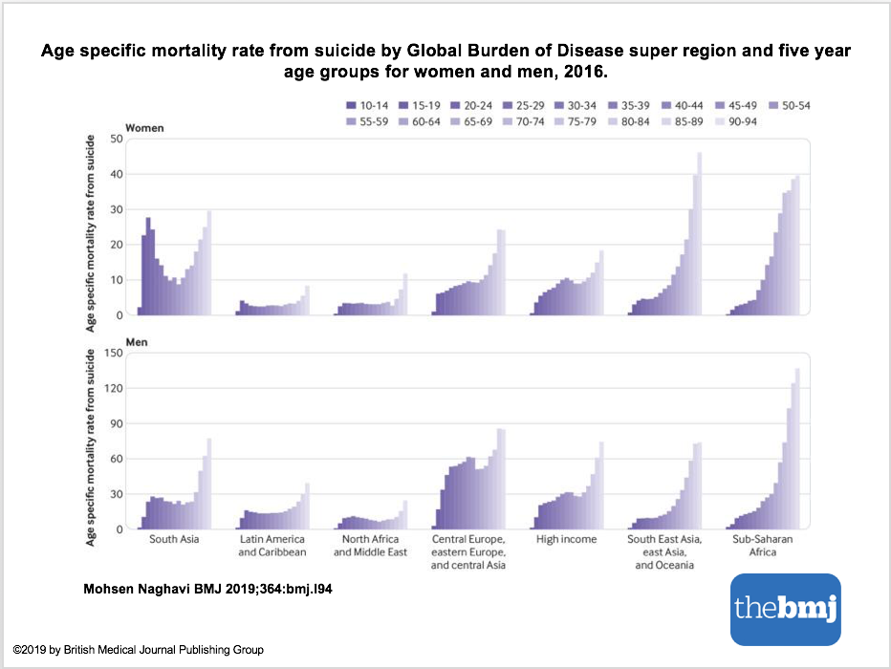
Suicide worldwide:
Gender and age distribution
Naghavi (2019)
Notes:
DESCRIPTION FROM BMJ PAPER OF FIGURE 5:
This shows that, for men and women and across all regions, rates of suicide mortality were highest for the oldest age groups. However, suicide did not rank in the leading 10 causes of death for those aged 70 and over (supplementary fig 3A). At the same time, regional variation in the overall age distribution of mortality rates from suicide was notable – with comparatively high rates for younger adults in several regions. In the 10 to 24 age group, suicide was ranked in the leading five causes of mortality in all Global Burden of Disease regions except for central, eastern, western, and southern sub-Saharan Africa (supplementary fig 3B). Figure 5 shows that a bimodality in the distribution of age specific mortality rates was particularly evident for women in south Asia and for men in central Europe, eastern Europe, and central Asia and in north Africa and Middle East. Across the time series, global mortality rates from suicide were greater, although not significantly so, for women than for men only among those in the 15 to 19 age group (supplementary table 4), although the gap in this age group has also decreased over time (supplementary fig 4). In 2016 mortality rates from suicide for men exceeded those for women in all other age groups by as much as 2.98 times.

Slide 7
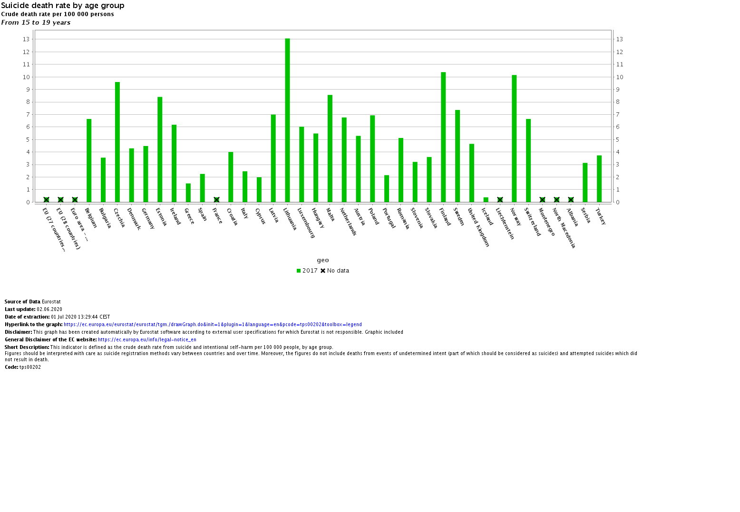
Suicide in Europe
M
Eurostat (2020)

Slide 8
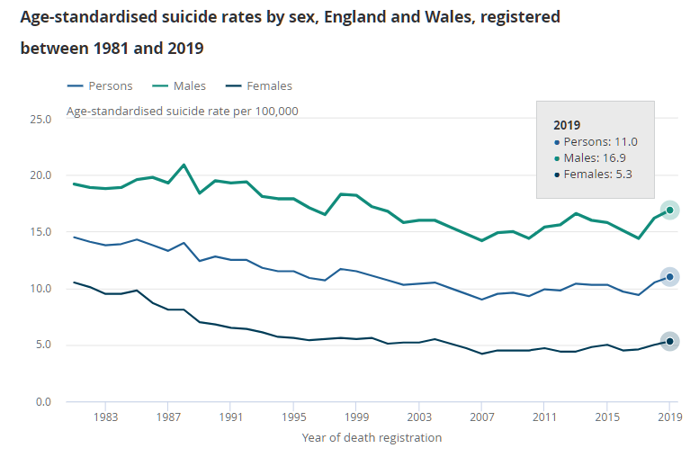
Suicide in the UK
Suicide rates in all persons, males and females increased in the past year
Male suicide rate in 2019 is the highest since 2000
Females suicide rate is the highest since 2004.
Source: Office for National Statistics – Suicides in England and Wales: 2019 registrations
Notes:
In 2019, there were 5,691 suicides registered in England and Wales

Slide 9
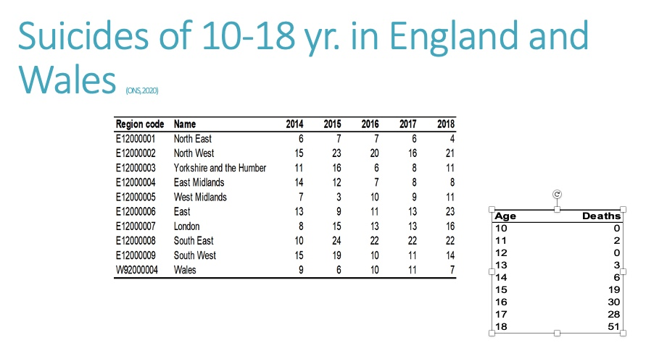

Slide 10
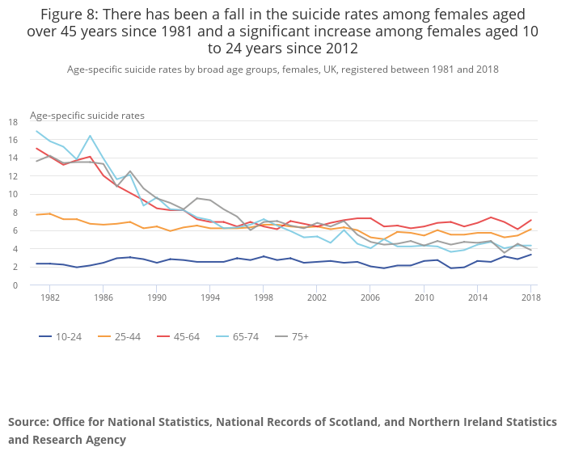
Suicide by females (ONS, 2019)

Slide 11
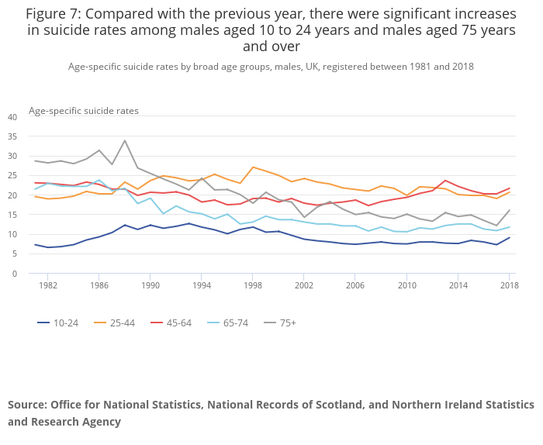
Suicide by males (ONS, 2019)

Slide 12
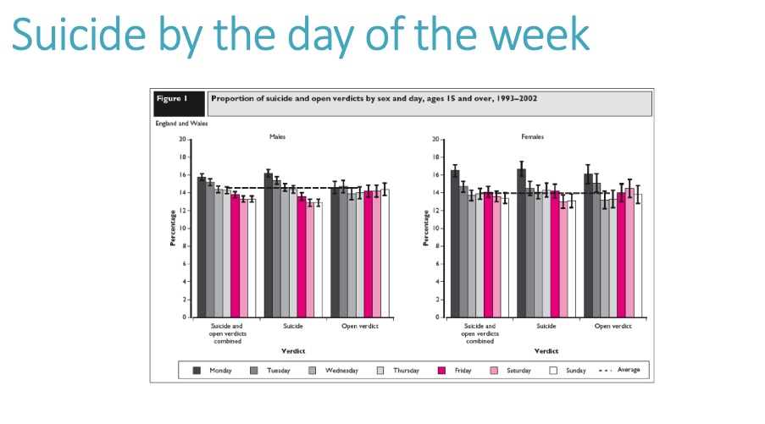

Slide 13
Suicide in people with ASD (Hirvikoski et al, 2016)
OR 7.55 (6.04–9.44)
OR 2.41 (1.14–5.11) – with ID
OR 9.40 (7.43–11.90) – without ID

Slide 14
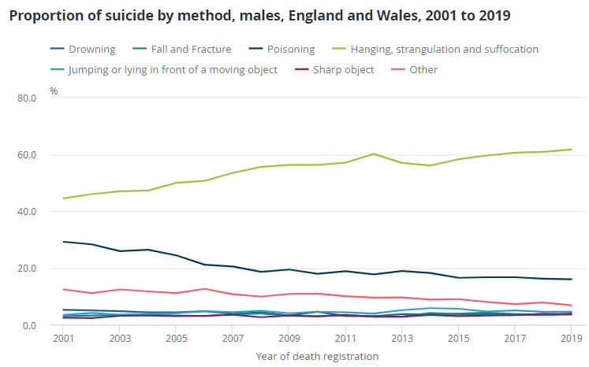
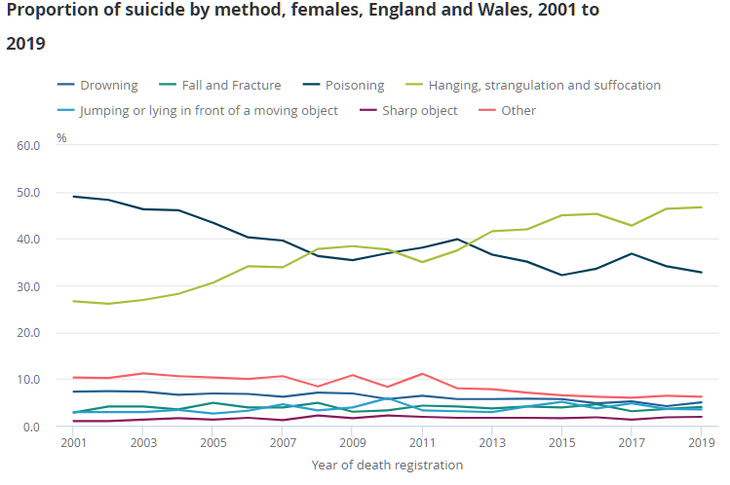
Suicide in the UK:
Suicide methods
Hanging, strangulation and suffocation (all grouped together) continued to be the most common method of suicide for both gender in England and Wales, followed by poisoning.
Source: Office for National Statistics – Suicides in England and Wales: 2019 registrations

Slide 15
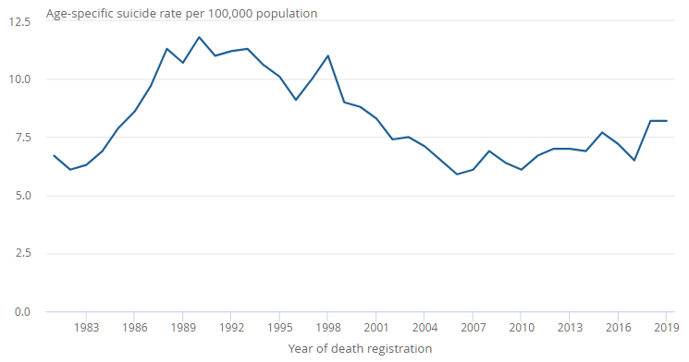
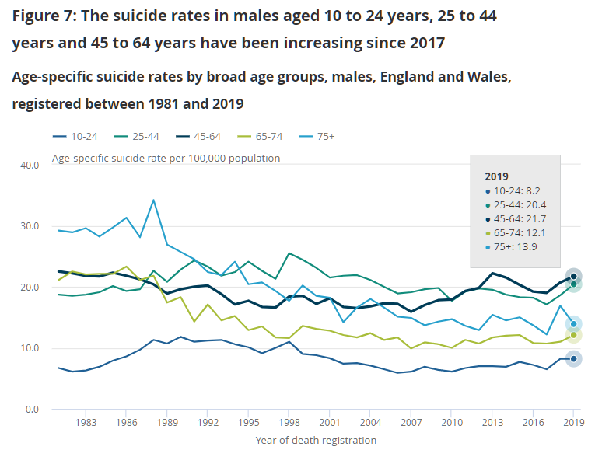
Suicide in the UK:
Males aged 10-24 years
Suicide rate of males aged 10-24 in England and Wales, registered between 1981 and 2019
2018: 440 deaths (8.2 per 100,000)
2019: 442 deaths (8.2 per 100,000)
Source: Office for National Statistics – Suicides in England and Wales: 2019 registrations

Slide 16
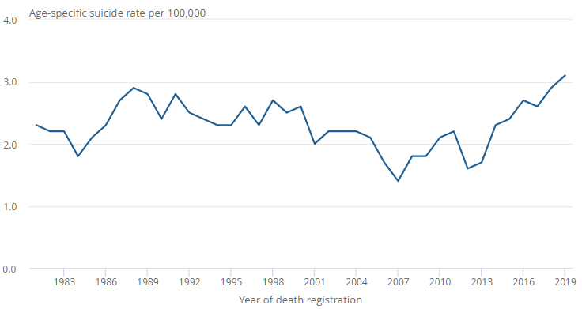
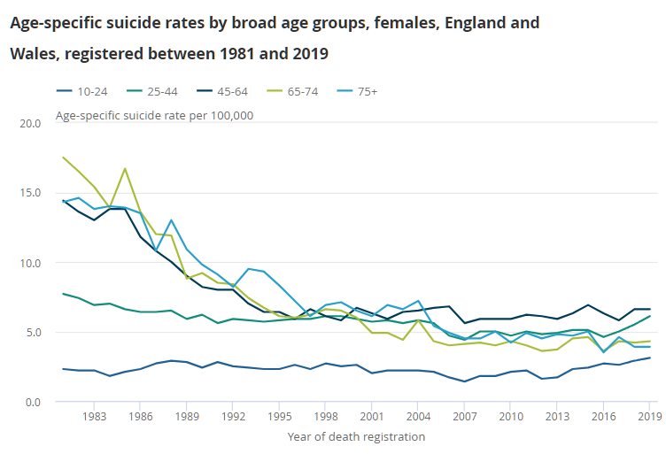
Suicide in the UK:
Females aged 10-24 years
Suicide rate of females aged 10-24 in England and Wales, registered between 1981 and 2019
In 2019, 159 deaths were recorded (3.1 per 100,000) – the highest recorded rate since 1981
Suicide rate in females aged 10 to 24 years in England and Wales has increased continuously since 2012
Source: Office for National Statistics – Suicides in England and Wales: 2019 registrations

Slide 17
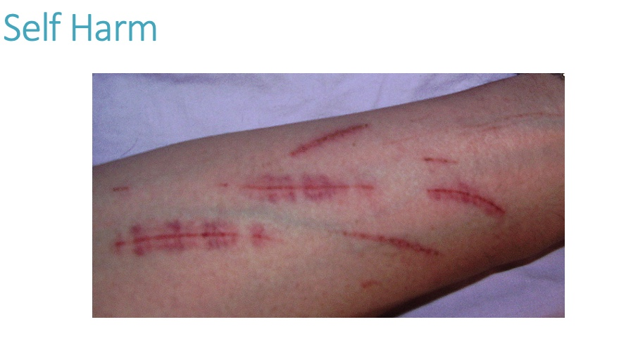

Slide 18
Prevalence of self harm in school pupils in countries participating in the Child and Adolescent self harm in Europe (CASE) study by gender (Hawton et al 2006)
country | self harm meeting | study criteria
 | previous year (%) | lifetime (%)
 | females | males | females | males
England | 10.8 | 3.3 | 16.9 | 4.9
Ireland | 9.1 | 2.7 | 13.5 | 4.9
The Netherlands | 3.7 | 1.7 | 5.9 | 2.5
Belgium | 10.4 | 4.4 | 15.6 | 6.8
Norway | 10.8 | 2.5 | 15.3 | 4.3
Hungary | 5.9 | 1.7 | 10.1 | 3.2
Australia | 11.8 | 1.8 | 17.1 | 3.3

Slide 19
Self-harm in young people with ASD (Duerden et al, 2012)
Lifetime prevalence 50%
Key predictors:
Abnormal sensory processing
Sameness
Impaired cognitive ability
Social functioning

Slide 20
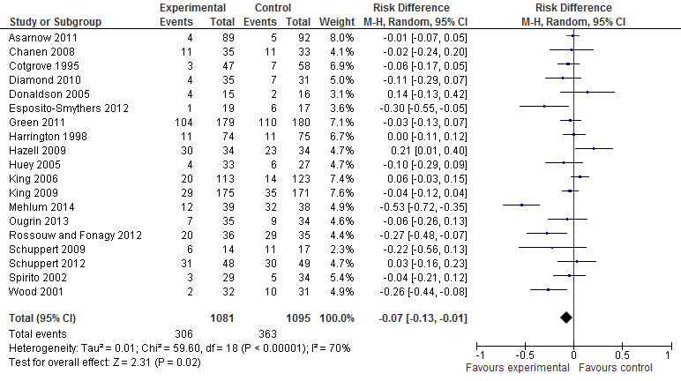
Self-harm: treatment
Largest effect sizes: dialectical behaviour therapy (DBT), cognitive-behavioural therapy (CBT), and mentalization-based therapy (MBT)
Ougrin et al. (2015)

Slide 21
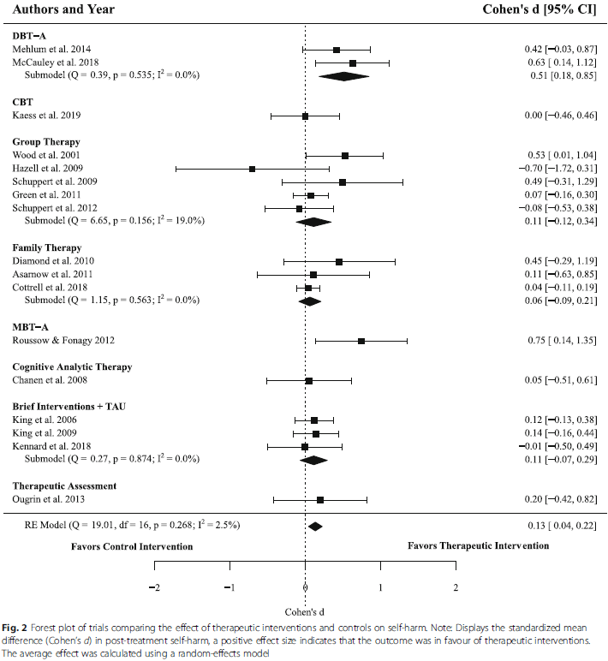
Self-harm: treatment
Current interventions are overall effective in treating self-harm in adolescence.
(d = 0.13, 95% CI 0.04–0.22, p = .004)
DBT-A showed moderate effects in reducing self-harm.
(d = 0.51, 95% CI 0.18–0.85, p = .002)
Kothgassner et al. (2020)

Slide 22
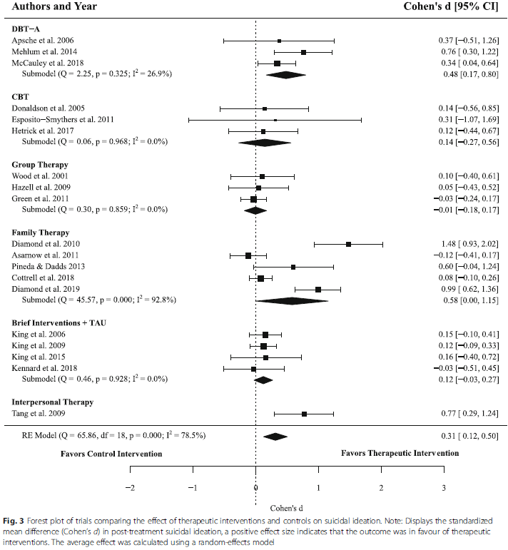
Self-harm: treatment
Treatments for suicidal ideation in adolescence are effective
(d = 0.31, 95% CI 0.12–0.50, p = .001)
DBT-A and Family-centred therapy have moderate effects in reducing suicidal ideation
Kothgassner et al. (2020)

Slide 23
POLL: Which of these are risk factors for self- harm?
Autism spectrum disorder
Worries about sexuality
Low self-esteem
Family conflict
Bullying victimisation
Low level of education

Slide 24
Risk factors for self-harm
Suicidal ideation and depressive symptomatology (Vitielo et al., 2009)
Psychotic symptoms (Kelleher et al., 2013)
ASD (Duerden et al, 2012)
Early-onset (< 16 years) cannabis use in females (Wilcox et al., 2004)
Conduct, hyperkinetic, and emotional problems in males (Sourander et al., 2009)
Worries about sexuality, anxiety (O’Connor et al., 2009)
Low self-esteem, external attributional style (Martin et al.)
Bullying victimisation (Fisher et al., 2012)
Family conflict, History of NSSI (Brent et al., 2009)
Previous suicide attempt, use of a ‘hard’ method (Hulten et al., 2001)
Rehospitalisation (Czyz et al., 2016)
Childhood abuse (Wan et al., 2015)
History of sexual abuse, family self-harm (O’Connor et al., 2009)
Living in a non-intact family (Sourander et al., 2009)
Low level of education (Brunner et al., 2007)

Slide 25
From suicidal thinking to
suicide attempts
Presence of psychiatric disorders
Female gender
Lower IQ
Higher impulsivity
Higher intensity seeking
Lower conscientiousness
A greater number of life events
Body dissatisfaction
Hopelessness
Exposure to self-harm in both friends and family
Smoking
Non-cannabis drug use
Mars et al. (2019)

Slide 26
Risk factors for completed suicide
Male sex
Low socioeconomic status
Restricted educational achievement
Parental separation or divorce
Parental death
Adverse childhood experiences
Parental mental disorder
Family history of suicidal behaviour
Interpersonal difficulties
Mental disorder
Drug and alcohol misuse
Hopelessness
Hawton et al. (2012)

Slide 27
Long term follow up A&E presentations
Repetition in 27.3%
Age
Self-cutting
Previous self-harm
Psychiatric treatment
Death in 1% (50% suicides)
The method used was usually different to that used for self-harm.
Male gender
Self-cutting
Prior psychiatric treatment
History of previous self harm
Hawton et al. (2012)
Violent versus non-violent self-harm makes you 8 times more likely to die
Beckman et al. (2019)

Slide 28
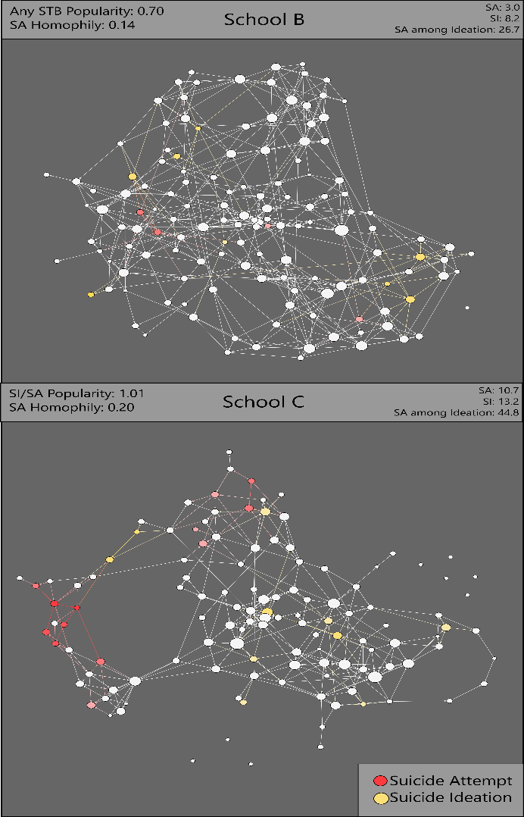
Peer-adult network structure and suicide attempts in 38 high schools: implications for network-informed suicide prevention
School networks could provide the relationship network structure that will potentially prevent suicidal behaviour
Lower peer network integration and cohesion in schools had higher rates of suicidal ideation (SI) and suicide attempts (SA)
Suicidal attempts increased with two factors:
Student isolation
  10% more students isolated from adults led to 20% higher SA rate on average
Popularity of student and clustering on network
  Higher relative to non suicidal peers
Wyman et al. (2019)
Notes:
Figure shows differing social influence of suicidal youth in two schools. Darkness of shading reflects clustering of students with suicidal thoughts/behaviours (STB). Nodes are sized by in-degree (i.e., popularity). In School B, students with STB are relatively less popular vs. no STB compared to School C. Additionally, students with SA cluster less in School B vs. C. School B has lower SA rates than School C.

Slide 29
Risk assessment: future
Implicit associations https://implicit.harvard.edu/implicit/user/pimh/index.jsp
Machine learning https://www.nature.com/articles/s41398-020-01100-0

Slide 30
IDENTIFYING EMOTIONS
1.Describe the situation
2.What caused the situation
3.Primary and secondary emotions
4.Identify your urges
5.What did you do
6.Outcome
Is emotion regulation the key?
Part of DBT

Slide 31
OPPOSITE ACTION
Is emotion regulation the key?
Sad – Withdraw (A) – Communicate and go out with friends (OA)
Part of DBT

Slide 32
PLEASE
Is emotion regulation the key?
PL Treat Physical Illness
E Eat Healthy
A Avoid Mood-Altering Drugs
S Sleep Well
E Exercise
Part of DBT

Slide 33
Paying Attention to Positive Events
Have a good, unrushed meal
Watch a movie
Visit with friends or family.
Visit a local attraction.
Go for a walk.
Put on headphones and do nothing but listen to music.
Have a picnic.
Give yourself a relaxing night in.
Try a new hobby.
Is emotion regulation the key?
Part of DBT

