Slide 1



Re-engaging young people back into education after a period of absence by looking at new ways to promote and deliver our service to the increasing number of vulnerable young people who have mental health challenges and who are not taking part in education.
Dr Cat Halligan and Jemma Michelson
J

Slide 2

Overall Aims
Schools
Supporting educational colleagues in mainstream schools to re-engage young people who have not fully returned to school after national lockdowns
To work with teachers/school leaders to prevent avoidance becoming entrenched.
Young People
To help students to re-engage with and enjoy learning and education
To help students make progress in their transition back into education
To help students identify their thoughts and feelings about school and plan some strategies to support them to re-engage
J

Slide 3
Development of the Programme
LinkEdUp began as an idea in the summer of 2020 in the wake of the COVID crisis. It became clear that some young people were unlikely to want to return to school even once it was possible to do so. RFHCS (lead by Mike Kelly) conceived of a course which would reach out to those young people online through the zoom.
The zoom sessions would be aimed at helping young people come to terms with their anxieties about returning to school, and would seek re-engage them by establishing links with staff from their own school.
MK curated a two week program of study- to be delivered by RFHCS teachers to young people who were currently not attending school for a variety of different reasons (e.g. fears of contracting COVID, shielding to protect vulnerable relatives)
In the Summer term, the offer was made to all SENDCOs and Headteachers throughout Camden.
Of the schools who did show interest, we reached out to six or seven young people who were very vulnerable and in great need of what we had to offer which included; Drama Therapy, Art, Music, Maths, English and Thinking Cards.
J

Slide 4

Development of the Programme
    Could follow up support be offered in the new pilot programme?
    Better outcomes for young people
    Reintegration or sign posting to alternative pathways
    Support for schools to understand the needs of young people with EBSA and how to support them
    Emotional support for parents
    More graduated return to school in small steps
C

Slide 5
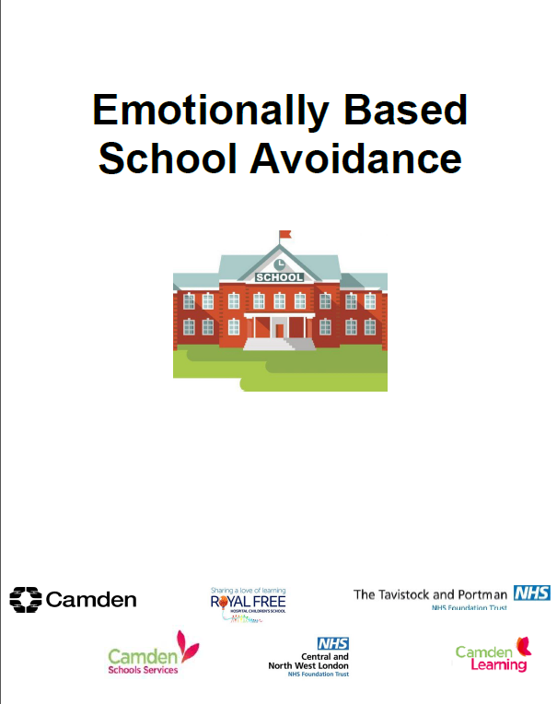
Development of the Programme
Covers:
Definition and terminology around EBSA
Indicators of EBSA
Risk and resilience factors
Seeking information from children and parents to inform interventions
Strategies for home and school
Graduated approach to returning to school
Pathway of support

Slide 6
Development of the Programme
Underpinning Psychology
Understanding the underlying push and pull factors contributing to EBSA, including feelings of anxiety
Bespoke intervention plans that are informed by the child’s push and pull factors contributing to school avoidance, planned by family, school and the young person
Teaching about anxiety and strategies to cope with these feelings
Prioritising feelings of psychological safety by creating plans that are predictable and consistent
Supporting the development of nurturing relationships between LinkEdUp teachers, parents, schools and students
Use of cognitive behavioural approaches to plan gradual, step by step re-engagement with school
C

Slide 7



Development of the Programme
“School [avoidance] occurs when stress exceeds support, when risks are greater than resilience and when ‘pull’ factors that promote school non-attendance overcome the ‘push’ factors that encourage attendance”
Thambirajah et al. (2008)
Environmental factors can be instrumental in supporting a young person back to school
Notes:
imbalance

Slide 8


Development of the Programme
Parental illness
Separation anxiety
Bullying/difficult peer relationships
Difficulty accessing learning
Risk factors
What push and pull factors do you see?
Pull to
Push away
Push away
Pull to
Parent/carer wants child to attend school
Good relationship with Head of Year
Resilience factors
Notes:
https://www.menti.com/cczeq75xta

Slide 9
LinkEdUp Programme
A two week, online programme for secondary age students who struggle to attend school
Sessions via Zoom delivered by Royal Free teachers and EP
Follow up meeting with home and school to discuss individual push/pull factors, create goals and put together a support plan
Ongoing support for parents through weekly phone calls
Review meetings with home and school to discuss progress and tailor plans
Art
  Music
  Drama & Relaxation techniques
  An introduction to self-help for anxiety through thinkingcards.org
  Science
  Mathematics
  EP session x2
  End of programme ‘celebration’ session
J

Slide 10
LinkEdUp Programme
Themes within Referrals
39.7% average attendance of all young people referred
Reasons for non-attendance consisted of three main ideas:
  Struggling with accessing the ‘learning in lessons,’ (academic work)
  Physical environments of school
  Maintaining and managing friends, friendship groups and relationships at school
More specific areas of commonality:
Every young person referred had anxiety noted as a barrier to attendance
10/10 young people had SEMH noted as an area of concern
3/10 engaging with support from Early Help services
2/10 had already been put on a part time timetable by their home schools
4/10 noted they were experiencing difficult relationships with their parents
2/10 had attempted to take their own lives on more than one occasion
7/10 note that friendships is an area which they struggle with
J

Slide 11
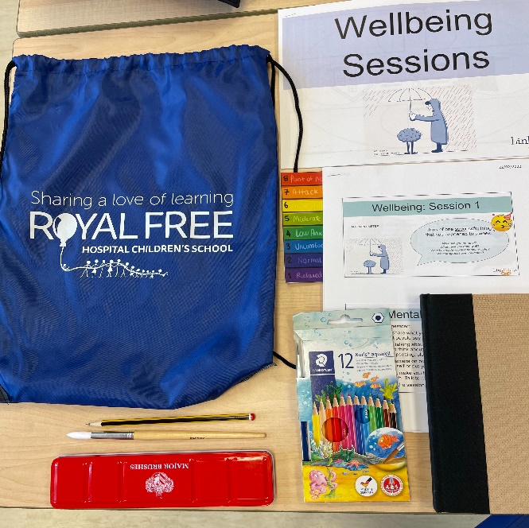
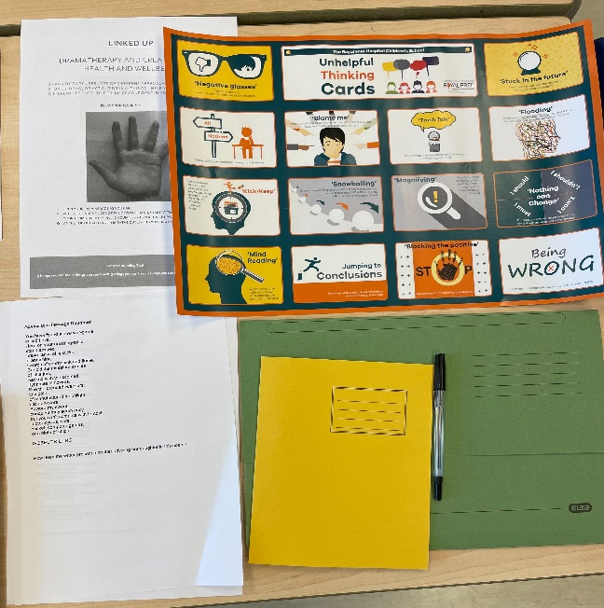
LinkEdUp Programme
Stationary for young people
Art sketch book
Water colours/water colour pencils
Paint brush
Note book
Mini White board and pen
English, Drama and Well-being printed resources
A3 ‘Helpful’ and ‘Unhelpful’ thinking posters
Wellbeing Session resources
J

Slide 12
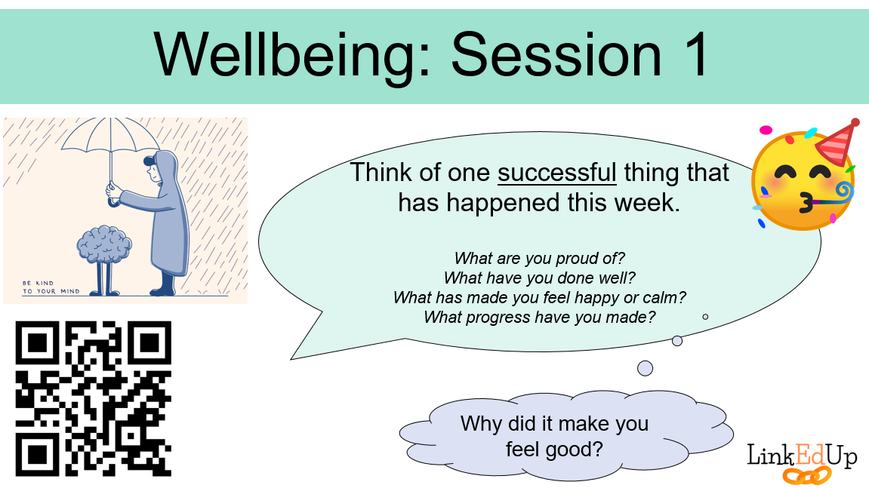
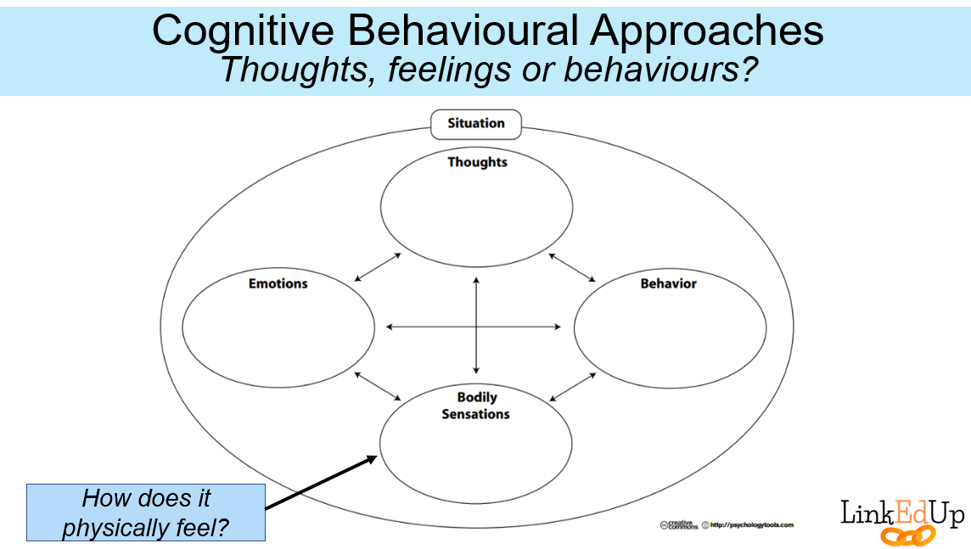
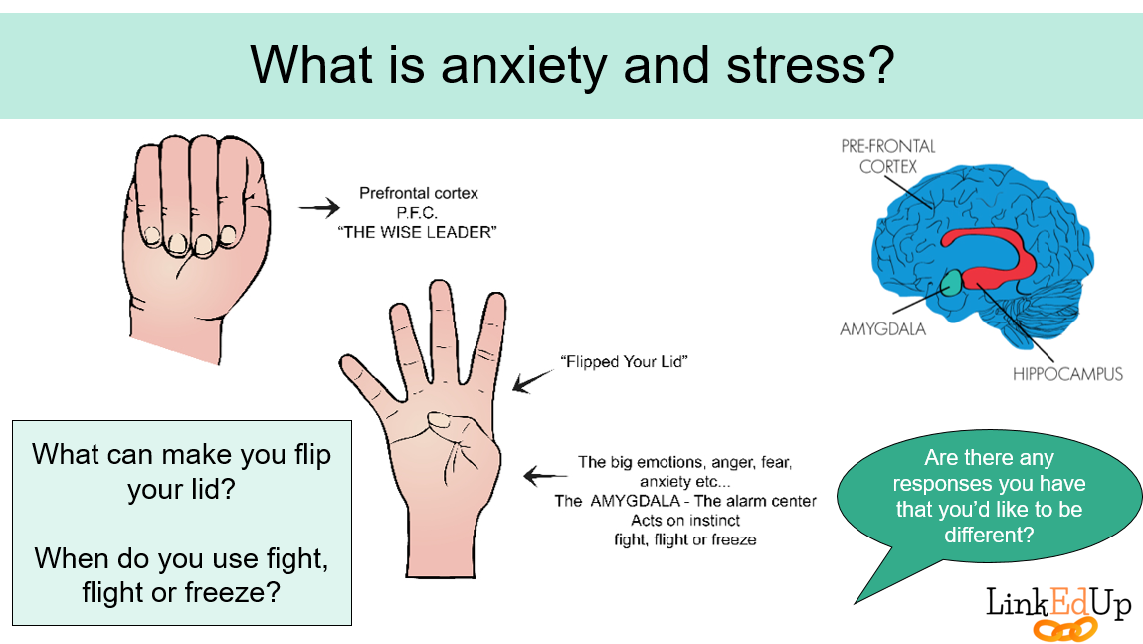
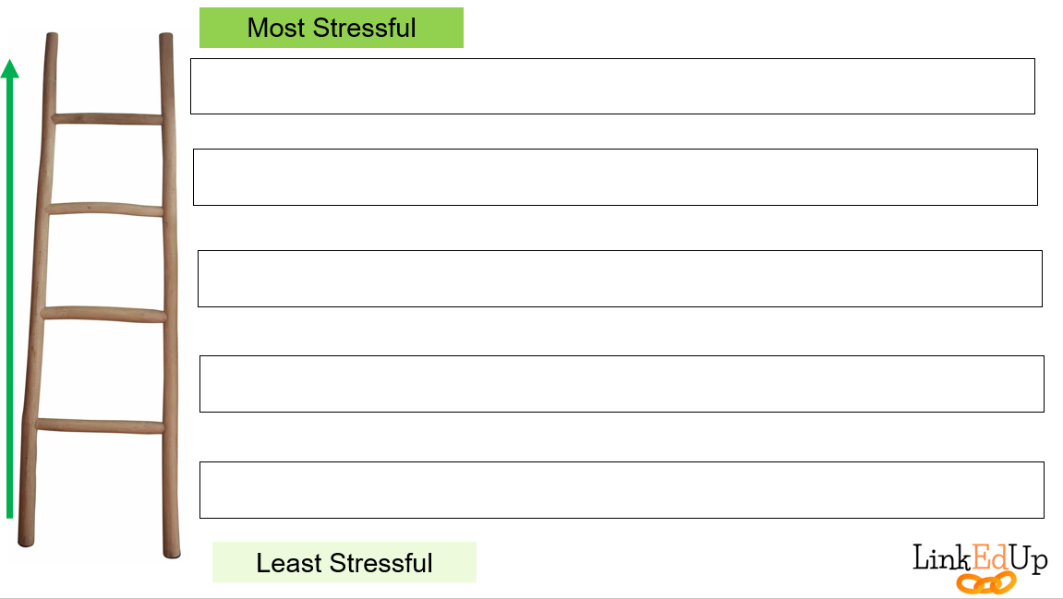
C

Slide 13
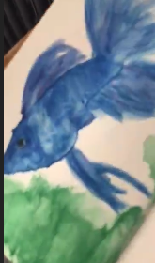
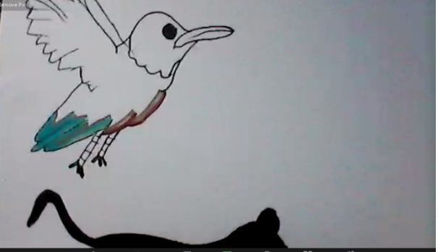
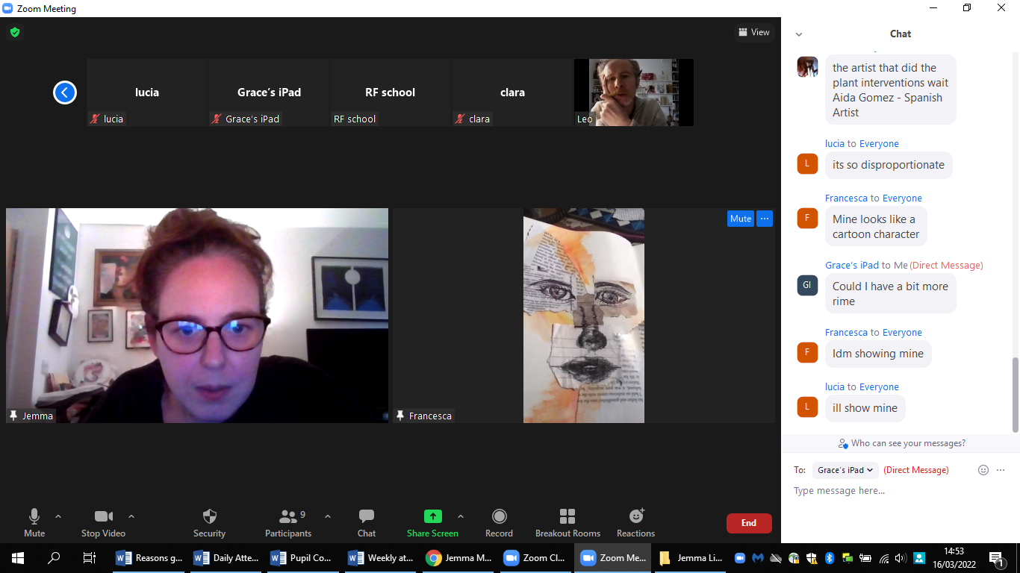
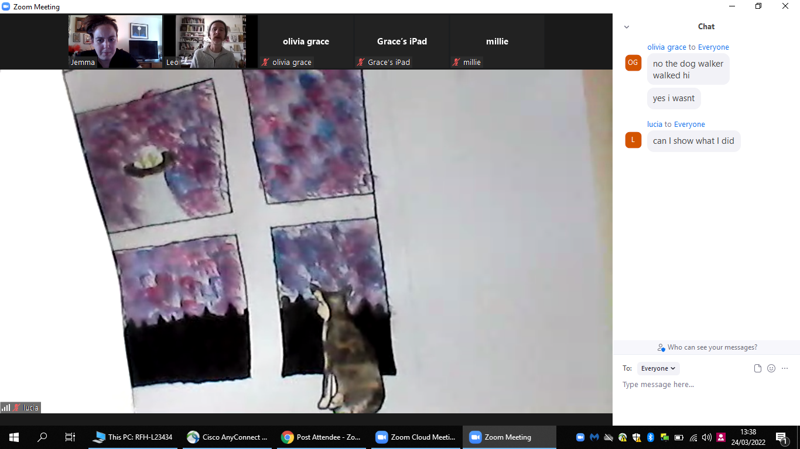
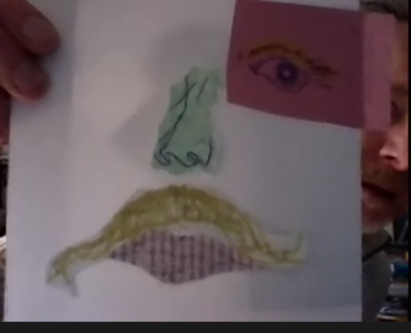
Outcomes and Impact
Engagement during the online programme
6/10 students attended very regularly. Engagement with parents about attendance was good. Some students joined from school, others from home.
Young people preferred not to out their cameras on and show themselves. We did not force this during the two weeks, instead the young people used ZOOM emojis to communicate with teachers as well as the chat function. This was to both share ideas, Art work, make comment or direct message session leaders.
Only 1 young person put their camera on in one session but in more than half of the sessions the young people spoke on the screen with encouragement, especially in Music and Art sessions.
J

Slide 14
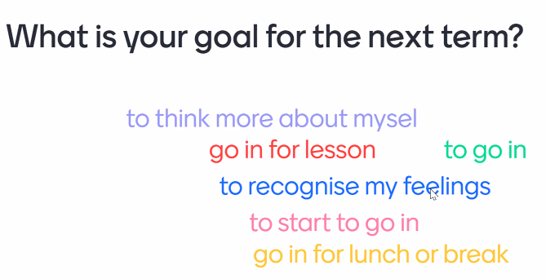
Outcomes and Impact: Student Feedback
Did you feel that LinkED UP was worthwhile? Can you explain in what ways?
Yes it helped so much with my anxiety
Yes this helped my confidence a lot
Kind of but I don't think it really helped me at all, I just think it made me like online school much more
It was worthwhile because I got to learn in surrounding I am comfortable in
Yes because when doing it I wouldn't worry or think of he negatives of school and it gave me a break and a good time.
J

Slide 15
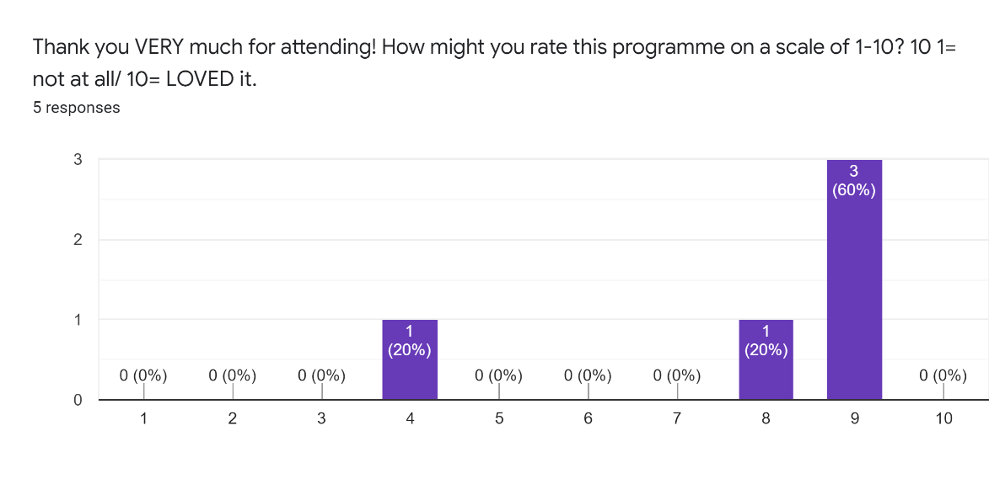
Outcomes and Impact: Student Feedback
J

Slide 16
Outcomes and Impact: Parent Feedback
Parents were really pleased that their child was engaging with learning again
  Many reported that they felt excited for their child, seeing them engage in something again
No- judgement
  Parents felt understood in their experience at home
Trust was built
  It felt like they trusted us and that we understood their child and some of what their experience was like at home.
Holding their anxieties
  The emotional energy that they had invested in trying every day to break the cycle of school avoidance was both physically and emotionally distressing.
J

Slide 17
Outcomes and Impact: Parent Feedback
This is the opportunity that could change a child’s life if they are struggling, it helped change my daughter and our plans for the better. Without the programme, I think my daughter would be in a much worse place. You have to engage with it, parents and child but the more you put in, I think the more you will get out. It might not be for everyone so be guided by the school.
The regular chats helped us plan and give us all support. When we are struggling, that time changes how you see things for the better, ideas to feel more positive. I don’t know how I coped at times but these 2 ladies made a massive positive difference to me
They are, empathic, listen, offer advice and support, no judgement. We as parents are new to this so I cannot state strongly enough how invaluable this whole resource was to child and parents. The follow up was v crucial. I feel without the help of Jemma and Cat, we would not have achieved this. They may well have helped change our daughter’s future for the better
J

Slide 18
Outcomes and Impact
Since the start of the LinkEdUp programme…
4/10 young people have physically stepped foot back into their home school building.
6/10 young people are all engaging with some form of education again.
5 young people have in some way either re-integrated back into school- be it full/part time in a phased approach or are engaging with academic learning with their home school which they had not been doing for some time before starting LinkEdUp.
2 young people have since been signposted to alternative, more specialised SEMH provisions within their local authority.
1 young person has been granted an EHCP and has good attendance at an alternative provision in the borough.
C

Slide 19
Outcomes and Impact
C had attended for 13 days since September 2021 and had struggled to leave her home since the start of the pandemic as a result of anxiety. At the first review meeting, CB was attending school on a Monday to collect work that had been put together for her and returning it on Friday. At the final review meeting, she had chosen GCSE options, met the Head of Key Stage 4 on site and attended school to complete some work outside the classroom with support, staying for lunch with her friends.
M had not attended school for half a term and felt unable to walk through the school gates. By the final review meeting, she had gone on to the school site multiple times, was engaging with more school related social activities (such as trips), had attended school for a small number of whole days and was completing more academic work at home
O had not attended school since January 2022. At the first review meeting, OG’s attendance was 75% and she was attending more consistently, developing friendships at school
C

Slide 20
Conclusions
An online programme, offering a varied programme of subjects can work to engage young people back into learning
EP sessions as part of the online programme helped both EP and young people to attune to the bigger ideas about school avoidance and the anxieties young people may have been experiencing
We realised half way through that our original cycle of follow up was not long enough, more time was needed to assess re-integration plans, review, amend and set new targets.
Not just a programme about re-integration back into school. Reasons for young people not attending school in 3 particular cases was much bigger than that with issues around possible learning difficulties/neurodiversity's to be explored as well as severe mental health complexities. In these instances LinkEdUp offered not just re-integration plans back into schools.
    It also offered:
      Signposting to alternative provisions→ support for the referral process with this
      Support for referral to specialised services → health/educational and/or Early Help and Social Care
      RF school and EP support was able to offer educational/trauma informed and mental health expertise to schools and parents about possible formulations and support available
C

Slide 21
Conclusions
What’s next?
  LinkEdUp has been granted funding by Camden Learning secondary Head Teachers where we can offer every Camden Secondary School 1 placement for a pupil to engage in the new LinkEdUp cohort due to begin in the latter part of the Autumn term 2022/2023.
  We await feedback from parents and schools to collect data for analysis. We hope this feedback will support us to consider how we can improve every aspect of the next cycle of LinkED Up to support young people to re-engage with education academically and socially, becoming a part of school life once again.
J

