Slide 1
Food, Mood and Behaviour in Children
- From Micronutrients to UPF’s!
Dave Rex, Specialist Dietitian, Highland Council.
David.rex@highland.gov.uk

Slide 2
What, Why and How of Children’s Food
What (do some children eat? / What tends to be missing)
Why (does it matter? Impact on mood/behaviour/learning)
Why (do some children (and families) eat the way they do)
How (can we influence child nutrition for the better)

Slide 3
Factors influencing food choice
School food policy
Shops
Parenting style
Psychology of the child
Financial resources
Peer food culture
Catering outlets
Family food culture
Advertising & marketing

Slide 4
The 7 C’s
Cost – affordability of eating well
Commerce – determines the availability and promotion of different food types
Convenience - of processed foods - Ease of access, preparation & consumption
Culture – National, local and family food culture
Choice – too many appealing alternatives
Confidence – cooking/parenting etc
Child – Innate or acquired restrictive eating due to sensory & psychological differences
Diet is as good as the weakest link in the chain

Slide 5
Cost of food
Calories can be cheaper than nutrients
Cooking skills can make a low income more survivable
A lack of money inhibits risk taking, making dietary change harder

Slide 6
Impact of income on ability to follow Eatwell Guide
Taken from: Scott C et. al (2018) The Affordability of the UK’s Eatwell Guide. The Food Foundation.

Slide 7
Impact of food on mood, attention & learning
Short Term
  Regular eating pattern
  Impact of fibre/fat/protein
Medium Term
  Micronutrient status
  Microbiome

Slide 8

Short term

Slide 9
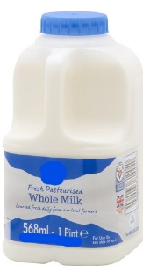
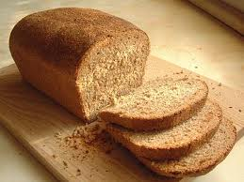
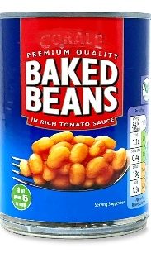
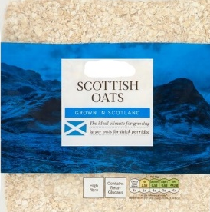
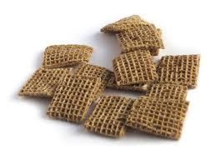
Blood Sugar “Roller Coaster”
+
Sugar in blood (From digested food)
Good mood, attention & energy
Low energy & poor mood
No breakfast
No lunch
Breakfast
Morning
Snack
Lunch

Slide 10

Medium Term

Slide 11


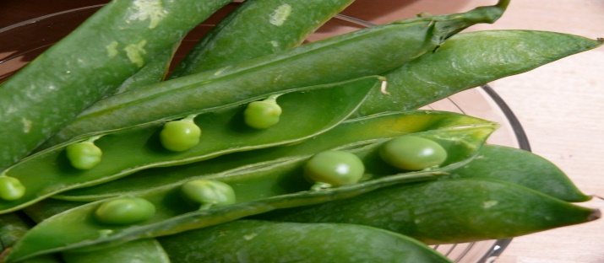
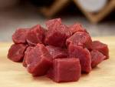

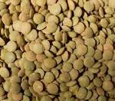
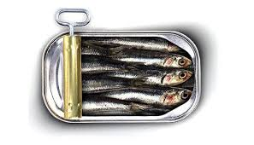
4 marginal “Brain Selective” micronutrients often lacking
Magnesium
Vitamin D
Iron
Omega 3

Slide 12
Omega 3 as an example of a missing brain selective nutrient
Visit www.fabresearch.org for more information
Also look at: https://foodandmoodcentre.com.au/
The next few slides are used with the permission of Dr Alex Richardson of food & Behaviour Research. I have personal permission to use these as part of training and education but they are not for use by others.

Slide 13
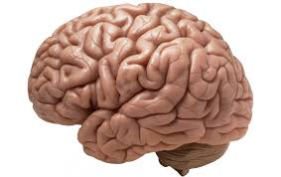

The Human Brain is
60% FAT and it matters what kind
Omega-3 (and Omega-6) LC-PUFA are Essential for Healthy Brain Development

Slide 14
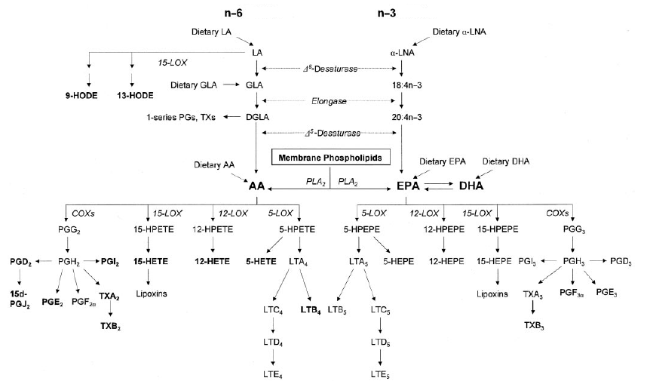
‘Functional Fats’: Conversion of Omega-3 and Omega-6 to Regulatory Substances
Endocannabinoids
(Synaptamide)
Resolvins
DGLA
Docosanoids
(neuroprotectins)
Endocannabinoids
(2-AG, Anandamide)
AA
EPA
DHA
Omega-6
Pro-inflammatory
Pro-coagulant
Omega-3
Anti-inflammatory
Anti-coagulant

Slide 15
Long-chain Omega 6/3 Dietary Imbalance
Converted – from LA in Vegetable Oils
Ready made – AA from Meat, Dairy Fats, Eggs
Omega-3
Converted – little ALA in most vegetable oils
Ready made – EPA/DHA from Fish and Seafood
Omega-6

Slide 16
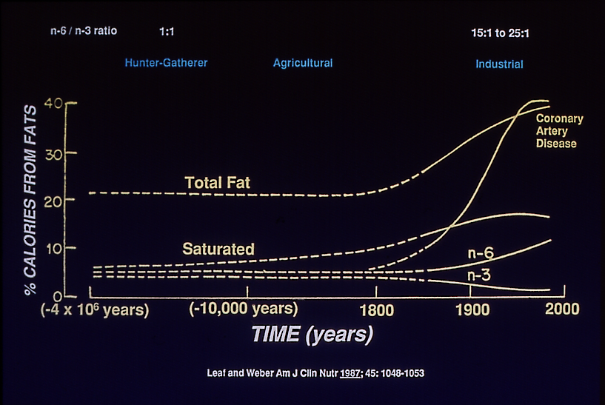
Changes in Dietary Fat Intake
Omega-6 / Omega-3 Ratio – Dramatic Increase
Notes:
Since industrialisation, total dietary fat has increased, and so has saturated fat (until very recently).
With respect to polyunsaturated fats, there has also been a very dramatic increase in the ratio of omega-6 to omega-3 fats – from around 1:1 in traditional hunter-gatherer diets to more than 15:1 in modern, western-type diets.
This has happened because we are eating more meat, eggs, dairy products and vegetable oils (omega-6), and less fish and seafood and green leafy vegetables (omega-3)
This chart also shows how heart disease (coronary artery disease) only became a major health problem following the industrialisation of our food supply. Like other degenerative diseases, its high prevalence today reflects mainly environmental, not genetic factors.

Slide 17
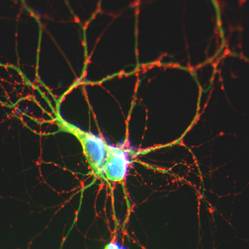
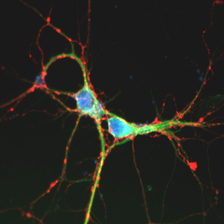
Maternal Omega-3 DHA deficiency impairs synapse development
Adequate DHA
Deficient in DHA
Synapes in
Hippocampal
Neurons
30 µm
Cao et al. J. Neurochem. 2009
Notes:
17

Slide 18

Gesch et al 2002: RESULTS
1133 offences: Active vs Placebo: -26.3 % (p ‹ 0.027)
And for violent offences only: “ -37.0%
(Gesch, C.B., Hammond, S.M., Hampson, S.E., Eves, A., Crowder, M.J. (2002) British Journal of Psychiatry 181 22-8).

Slide 19
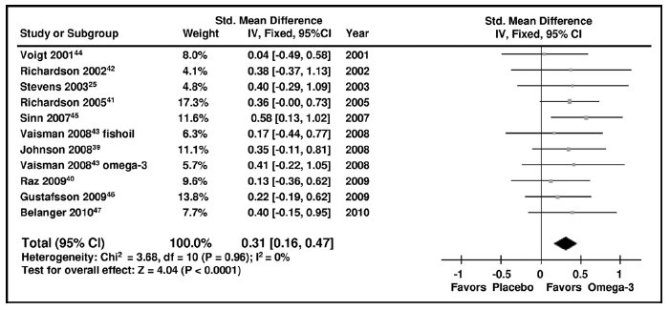

Omega-3 from fish oils are effective in reducing ADHD symptoms
Bloch and Qawasmi 2011, JAACAP

Slide 20
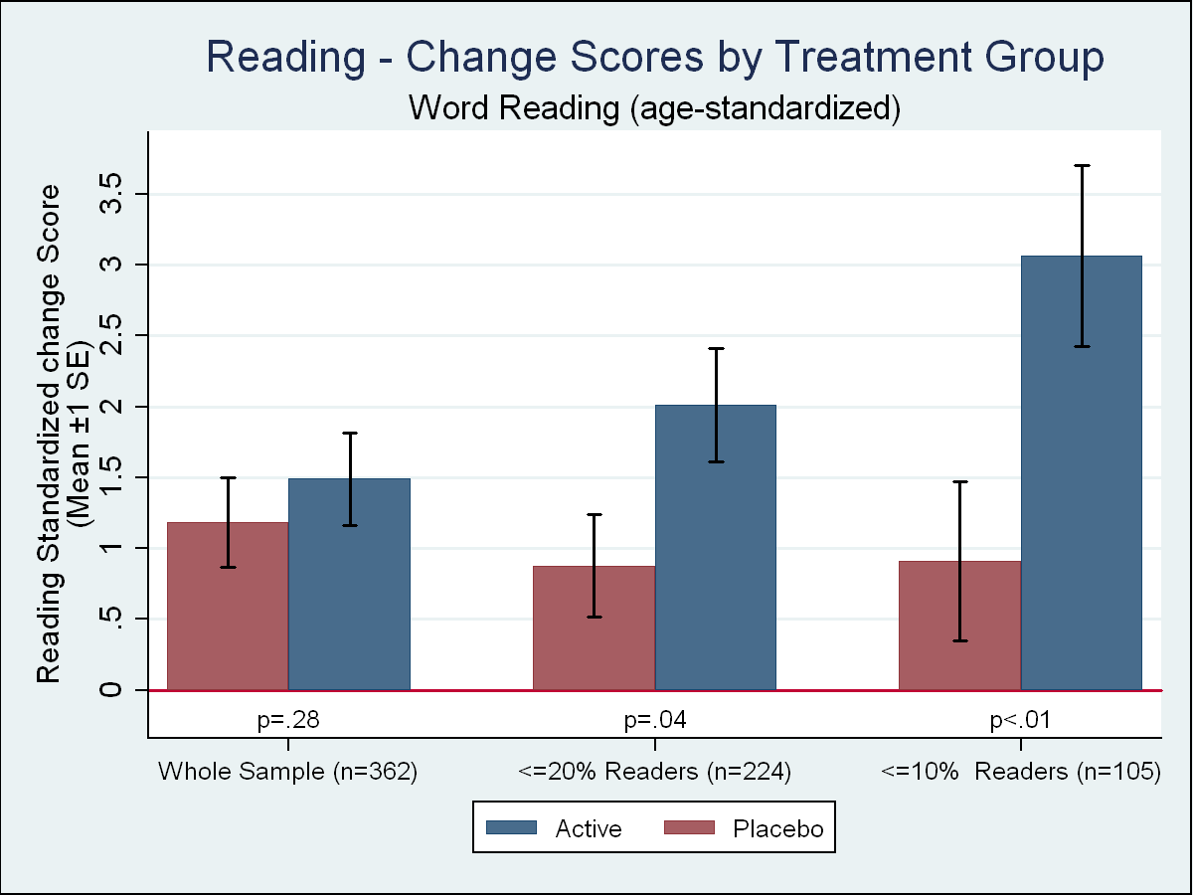
Reading
Richardson et al (2012) PLoS One,7(9):e43909 Epub Sep 6.

Slide 21
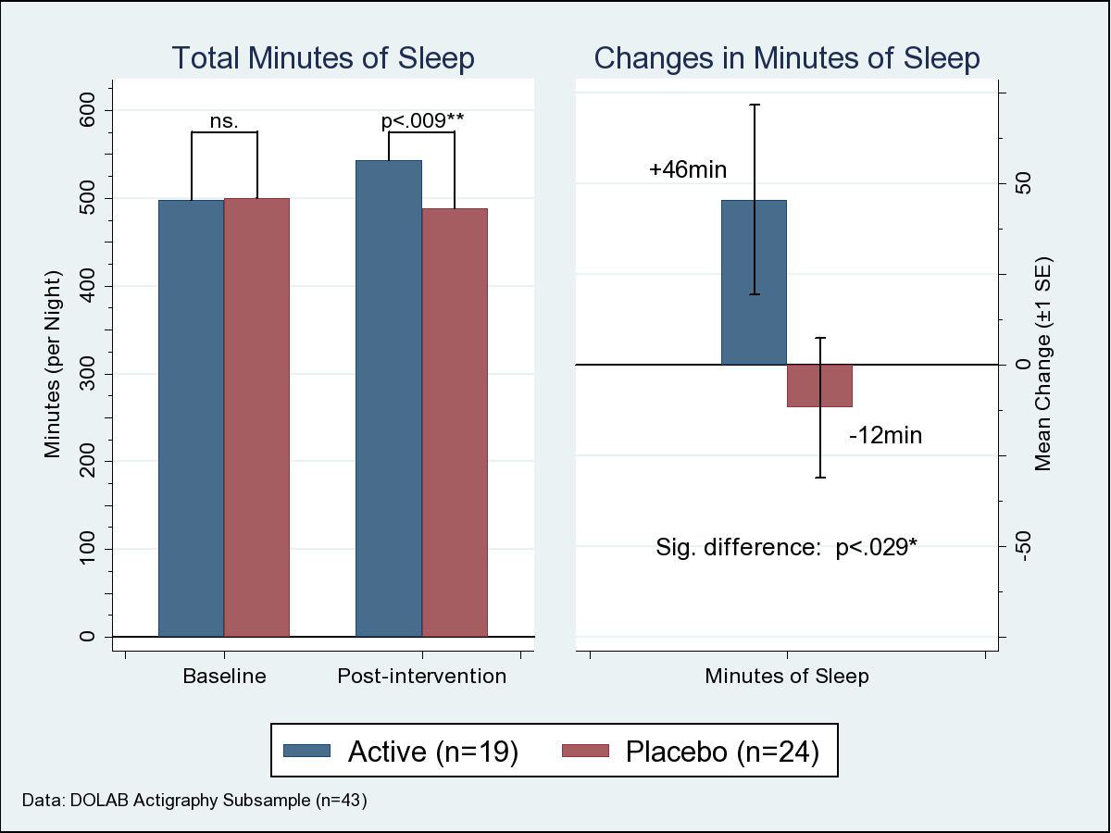
Children receiving DHA vs Placebo gained 58 mins more Sleep
Montgomery et al (2014) J. Sleep Research, March 8th

Slide 22
“Take home” message on
“Brain selective nutrients”
Some micronutrients are more important for the brain than others
Some are more likely to be insufficiently present in children than others
Omega 3 is just an example

Slide 23
Realistic Themes for Nutrition Education
Regular eating
Food processing
Varied eating

Slide 24
How can we help older children and families learn about regular eating and processed foods?

Slide 25
Blood Sugar “Roller Coaster”
Sugar in blood (From digested food)
Good mood, attention & energy
Low energy & poor mood
Time of day

Slide 26
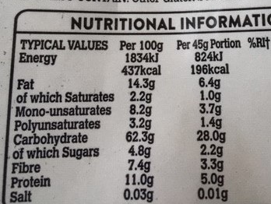
Breakfast cereals & Nutrition Labels
Check figures “Per 100g” on label.
Compare different cereals for:
  Sugars / 100g and
  Fibre / 100g
  Ratio of Sugar to fibre?
  Rank them in order

Slide 27
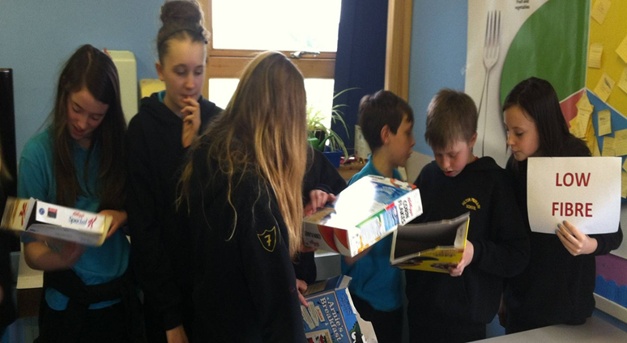
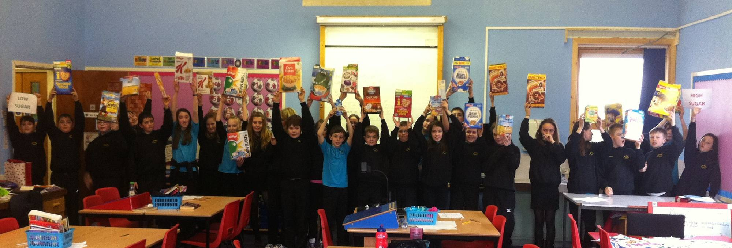
Critical consumer skills

Slide 28
Household availability of ultra-processed foods* and obesity in nineteen European countries
Monteiro, C A Et.Al (2017)
Public Health Nutrition: 21(1), 18–26
* aka: U.P.F’s

Slide 29


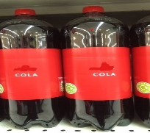
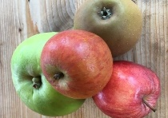
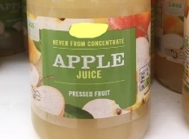
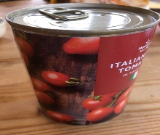
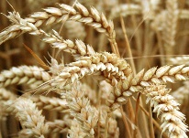
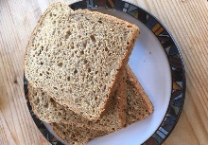
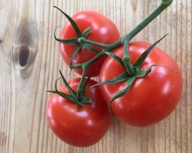
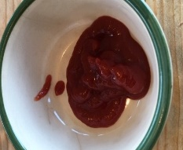
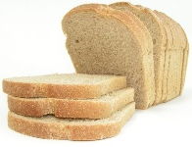

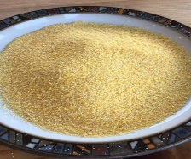
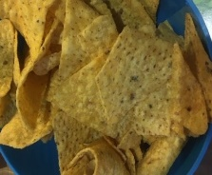

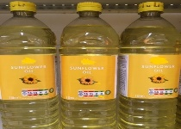
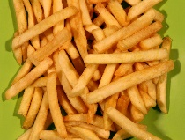

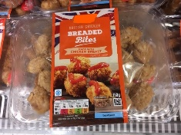
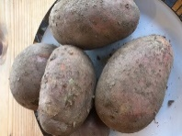

Effect of food processing
What gets removed?
What gets added?
Which can you eat and digest more quickly?
How is the microbiome affected?
Which are most heavily promoted?
Which do you enjoy most?
*
Notes:
The b.s roller coaster feeds nicely into this one. I often give participants a chance to look at these pictures (laminated and separate) and try to sort them out into which goes with or came from which etc.
These slides are essentially about food processing. The idea being that our teeth, jaws, stomach’s etc are designed to do this for us but that sometimes the food industry has already done that processing and in doing so, the physical and chemical composition of the food has been changed. I’ve carefully selected the pictures so that it can be clearly understood that:
The more processed foods are commonly available in our shops, convenient and heavily promoted. We should not be surprised therefore that such processed foods are a large part of many people’s diets.
Physical and chemical changes maybe be to do with physically breaking up (like milling or mincing), removing fibre or some nutrients, or adding colours, preservatives, salt, fat, sugar etc to make it last longer or look or taste more appealing.
Some processing is perfectly sensible: examples shown include milling wheat into flour, adding yeast, proving and baking into a wholegrain loaf; or picking tomatoes when they are in season and canning them.
Others like soft drinks, deep fried snacks etc might still meet our sensory needs in the moment (fizz, crunch, salty sweet etc) but if they become the core of our diet, we might feel like we are on the blood sugar roller coaster in the short term, and find ourselves having too few nutrients and fibre and perhaps a bit more fat, salt and sugar than our bodies can cope with.
The above topic should always be balanced with the concept of “Legitimizing foods”.

Slide 30
How can we help older children and families learn about the importance of eating a varied diet?

Slide 31
Heathy Eating Guidelines:
Eating a varied diet & staying hydrated are important for health
How helpful is the detail and language in the Eatwell Guide?
What are the risks for children in this kind of learning?

Slide 32
Problematic messaging in Eatwell Guide
Traffic light food labels
Everything in moderation?
Be afraid!
“…versions with less added fat, salt & sugar”
“5 portions of fruit and vegetables a day”
“Choose lower fat and lower sugar options”
Prescribed proportions for each “food group”
“Calories per day”
“Eat less and in small amounts”

Slide 33
How can we promote variety without fear?
Positive messages more than negative?
Only positive messages?
Is “Variety” enough as a message?
Can we find a useful analogy?

Slide 34


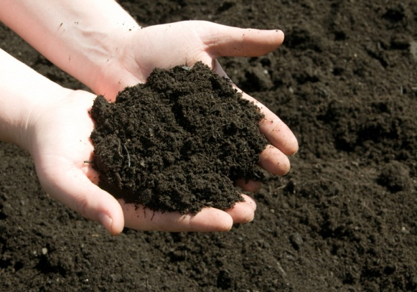

Air
C02
Oxygen
“Nutrients” in soil
“Nutrients in food”
Water
Sun
Notes:
This slide just summarizes the similarities and differences between us and plants, We both need air, sun, water and nutrients. Just as plants need nutrients, we get nutrients when we eat them!

Slide 35
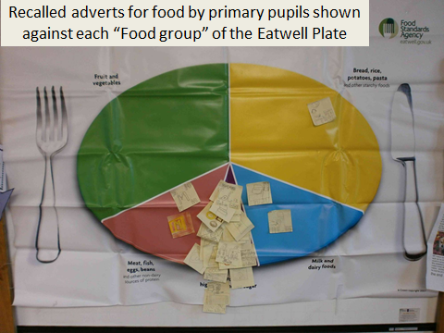
Eating guidelines compared with advertising

Slide 36
Understanding and influencing moderate to severe selective & avoidant eating
Why is my child so picky?
How is my child’s diet affecting them?
How could it affect them in the future?
What can I do about it?

Slide 37
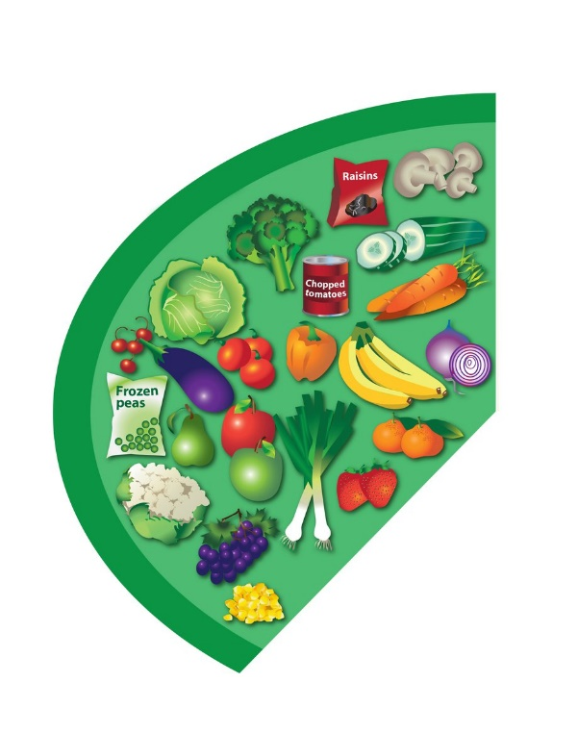






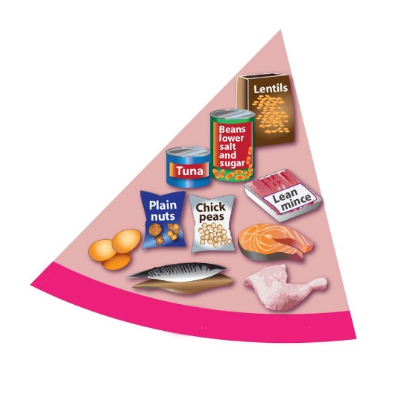
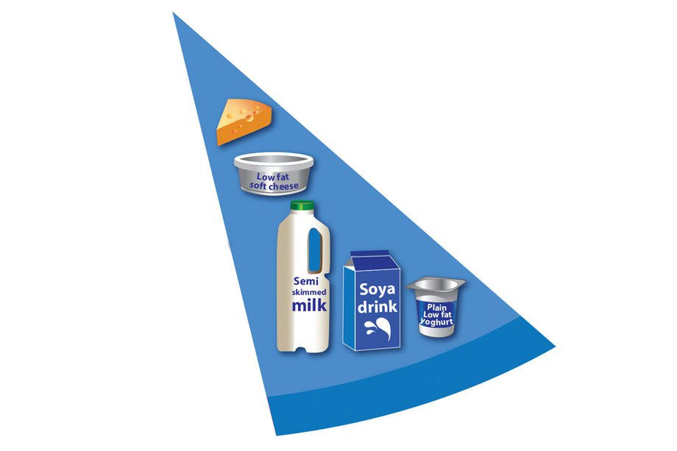

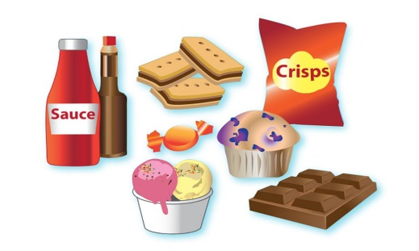

Slide 38
Impact of Selective and Avoidant Eating
Social
Emotional
Financial
Physical health
Brain function and development

Slide 39
Parental balancing act
Adequate growth
Sufficient variety
Enjoyable mealtimes

Slide 40
Reasons for selective eating
Age
Medical cause
Familiarity
Sensory preference
Fear of the unknown
Desire for routine
Food addiction and craving
Oppositional behaviour

Slide 41
Food addiction & craving
Need for routine?
Sensory seeking?
  Crunchy
  Chewy
  Salty, sweet or sour
Neurological effect?
  Sugar “craving”
  Gluten and casein
  (Opioid excess hypothesis)
  More guidance on how to consider the evidence between nutritional interventions in ASD & ADHD:
  https://www.thepineshighland.com/special-diets-for-children-with-autism

Slide 42
Selective Eating – Innate or Learnt?
Most examples of picky eating are innate.
It can be due to a lack of exposure.
Exposure and modelling helps.
Pressure, persuasion and rules may make things worse.

Slide 43
Terminology
Picking eating / food fussiness?
Selective?
More severe food refusal: ARFID

Slide 44
 | Picky Eating | Extreme Food Refusal (ARFID)
Picky stage? | Often grows out of it around 5 years of age | Continues into primary school years and beyond
Range of food | Limited tastes and textures avoided | Range limited to 10 foods or fewer
Texture | Slimy, very chewy, & stringy textures may be rejected | Very limited simple textures accepted. Might struggle with tooth brushing, or messy hands too
Anxiety | Might be a bit reluctant to try a new food | May be highly fearful with new food. Wider non-food anxieties too
Attention to visual detail | Not that bothered if it’s the right kind of food | Very loyal to specific brands, sensitive to changes in packaging or imperfections in appearance.
Influenced by peers | Foods become more accepted over time if your child sees their peers enjoying them | Peer modelling makes either no difference or if it does, very minimal

Slide 45
Picky eating or more extreme food refusal?
Picky Eating and extreme food refusal: psychological & sensory dimensions
More extreme & long lasting examples can be “ARFID”
ARFID = Avoidant or Restrictive Food Intake Disorder
Some children with ARFID show little interest in food
“Picky eating” may require favourite foods to be restricted
Preferred foods may be needed to keep ARFID child feeling safe*
For more on ARFID, visit https://www.beateatingdisorders.org.uk/your-stories/endeavour-blog/

Slide 46
Choice and “Holding out for something better!”
Food acceptance depends on….
What you think the new food will be like
What the new food actually tastes like
If there is a more appealing or familiar alternative

Slide 47
Most successful approach to tackling selective eating in young children
Good modelling (not persuasion or coaxing)
Appear not to care (whist still caring!)
Maximum exposure to the right foods
Realistic changes (appearance, concept, flavour, texture)
Consider limiting exposure to preferred foods
Involve in food preparation
Try self-service from shared dishes
https://youtu.be/pMcxiYb4ANc

Slide 48
Food | Colour | Taste & smell | Texture | Shape / size | Temperature | Brand | Kind of food
Chicken nugget | Yellow/brown | bland | Crisp and soft /chewy | Oval | Hot | McNugget | Breaded chicken
Fish finger? | Same | Same | Similar |  | Same |  | Similar
Roast chicken breast? |  | Same |  |  | Same |  | Similar
Turkey Dinosaur? | Same | Same | Same |  | Same |  | Similar
Hamburger |  | Same |  |  | Same | Same

Slide 49



Chicken nuggets | Fish fingers | Mince
Hot dogs | sausages | Eggs
Micro chips | Oven chips | Roast potatoes
Diluting juice | Pure fruit juice | Water

Slide 50
Sensory characteristics, language and categories
Help children to describe foods they like
Focus on adjectives for taste, smell and texture
Builds confidence (what they can do, not what they can’t)
Can help with planning new foods to try

Slide 51
For more guidance on understanding and influencing picky, selective and avoidant eating:
https://www.thepineshighland.com/understanding-managing-picky-eating

Slide 52
Vitamin & Mineral Supplements?
Nutrition from food is ideal!
Vitamin & mineral supplements can fill the gap
To find out more: https://youtu.be/uj3B3vP0Lx0
A poor diet is likely to need vitamins & minerals
This won’t provide fibre or protein

Slide 53
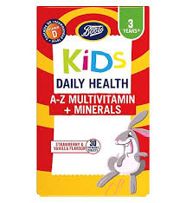
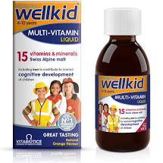
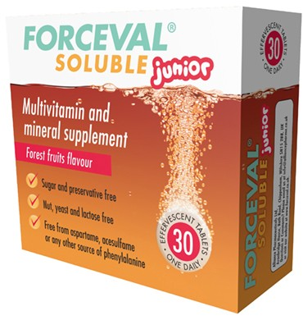


Supplements – Practical Consideration
Supplement | Guidance | Dosage | Possible impact | Who is it for?
Multivitamin and Mineral supplement | Make sure it includes Folic Acid, Iron, and a wide range of other vitamins and minerals. Can be liquid or “Chewable” (but not chewy) | Check the label. “Gummy” ones are often vitamins only and lack minerals. | Varied. Depends what was missing. Iron can improve mood, attention and energy. Zinc may improve attention, appetite and sleep. | Any child with a limited diet.
??

Slide 54

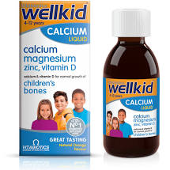
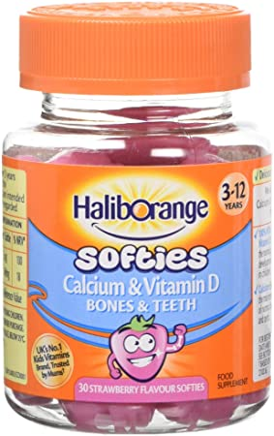
Supplement | Guidance | Dosage | Possible impact | Who is it for?
Calcium | Often missing from multivitamin and mineral supplements due to bulk. Calcium supplements often include other “Bone health” nutrients. | 350mg 1-3 yrs 500mg 4 - 10 yrs 1000mg over 10yrs. (half of figures above needed?)* *Some will be in diet already | Important for bone health. Bones need Vit D too. | If not taking at least 2 servings of milk, cheese or yoghurt a day. If using dairy substitutes, check if calcium is added.
Also Iodine? (Dairy/fish/eggs/
some milk substitutes)

Slide 55
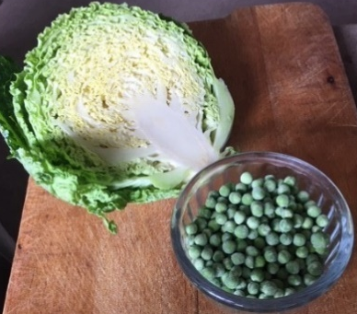


Supplement | Guidance | Dosage | Possible impact | Who is it for?
Magnesium | Often only a little in multivitamin and mineral supplements as it is bulky. Sometimes added to calcium “Bone health” supplements. | Age 1 to 6: 100mg Age 7 to 10: 200mg 11 upwards: 300mg. | Needed for healthy nerve function. Deficiency may contribute to anxiety. Also helps vitamin D do its job properly. | Children who do not eat green vegetables regularly.
??

Slide 56
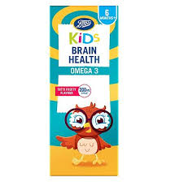

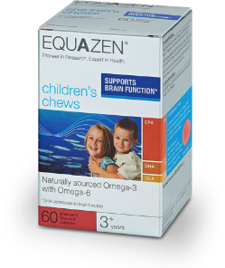
Supplement | Guidance | Suggested Optimum Dosage | Possible impact | Who is it for?
Omega 3 | Ideally these are from oily fish. They will contain “EPA” and “DHA” (Check the label). Ones with more EPA than DHA may be more effective. | Age 1 to 3: 250mg of EPA+DHA. Age 4 to 7: 500mg. Age 8 to 10: 800mg. Over 11yrs: 1000mg. | Important fat for brain cell membranes. Contributes to healthy nerve “signalling” and so can influence brain function. This could mean mood, attention, sleep…… | Children who eat oily fish less than one a week. Children with ADHD or ASD. Children with poor mood or sleep.
??

Slide 57
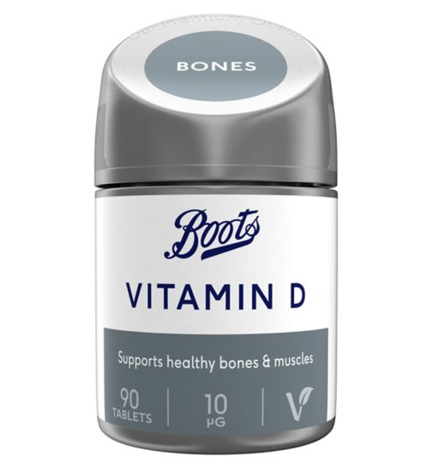


Supplement | Guidance | Dosage | Possible impact | Who is it for?
Vitamin D | Tablets range from 10 to 50 micrograms each. (10 micrograms = 400i.u’s) Drops also available. Already some in multivitamin supplements. | Minimum is 10 micrograms a day. Ideal may be 25 micrograms a day for pre-school & primary age children and 50 for older children | Needed for strong bones. Contributes to general health, possibly immune function and mood. Some specific evidence of benefit in Autism. | Everyone - especially children who spend little time outdoors. Heavier children; & those with dark skin tone more likely to need this.
??

Slide 58
Outcomes from consultations
Heightened parent/carer nutrition knowledge – often
Change in parent/carer nutritional priorities - often
Changes in child’s diet? – often slow & small or negligible
Changes in child’s nutrition – substantial with right supplements
Changes in parent/carer anxiety – significant
Lower parent/carer anxiety = less risk of harm

Slide 59
Summary
There is a bidirectional relationship between children’s food and mood.
Nutrition affects mood, attention, learning, behaviour in the acute phase (related to meal size and type, macronutrients and fibre)
Nutrition also affects mood (etc) over the longer term, reflecting micronutrient status and the microbiome.
Family food culture often falls short of optimum nutrition because sensory, emotional, practical and financial needs are prioritised
Children and families can be taught the importance of regular eating, varied eating, and the impact of food processing
Selective eating can be due to sensory preferences, fear of the unknown, or obsession with the familiar
Severe selective eating needs a conservative approach to management and mitigation of the risks

Slide 60

https://www.fabresearch.org/viewItem.php?id=15541&listId=341&categoryId=&navPageId=342
Selective or 'fussy' eating
- a masterclass:
Avoiding mealtime meltdowns, and motivating healthier food choices
Wednesday 25th January
6.00 – 7.30 pm (BST)
This event will be recorded - so if you can't attend live,
your booking will allow you to access it afterwards.
FAB Research Webinar and Q&A session
David Rex, RD, and Dr Alex Richardson will discuss the latest evidence-based research into what shapes children’s food preferences – with a focus on the areas of selective (‘fussy’ or ‘picky’) eating, and Avoidant Restrictive Food Intake Disorder (ARFID).
Book Your Place

